Slide 1
WEEK 1
FRONT END WEB DEVELOPMENT COURSE

Slide 2
PLAN
We will begin this week by practicing the command line, Git, Github, and exploring basic HTML. We'll create READMEs to include extra information with our projects on Github. We'll also learn a formatting language called Markdown to format READMEs. Then, we'll explore basic CSS to add styling to our web pages, and actually publish our sites online! Later in the week we will dive deeper into CSS by using divs and spans, floats, cascading, classes, ids, and the box model. Finally, we'll explore a tool called Bootstrap that offers even more powerful styling capability.

Slide 3
What you will learn from this Section
Navigate the command line to access and create directories and files
Use Git and GitHub to track the creation of static web pages
Create a static webpage using HTML
Style a static webpage using custom CSS rules in a linked stylesheet
Create a project README.md in Markdown
Adapt a webpage for responsive design

Slide 4
Week1 Project Objectives
Use the most common HTML tags:
p, h, ul, ol, li, em, strong, a, img, div, span
Implement standard indentation and spacing conventions of HTML
Make Git commits regularly with clear messages that finish the phrase "It will…"
Add a README to the GitHub repository that includes:
Author name
Project or program name
Description of program
Program setup instructions
Link to live version of site on GitHub Pages
Copyright and license information

Slide 5
Command Line Interaction
One of the first tools every developer needs to get familiar with is the terminal. No matter which language you use, you will be using the terminal a lot. As a person new to programming, using the terminal interface of a computer may be something you'll do for the first time in this lesson.
When you open up your computer and want to access a file or program, it's likely that you do this using a graphical user interface, or GUI. This is simply the graphical, or visual, part of a computer program that the user can interact with.
The GUI gives us a visual representation of what the computer program is doing underneath the hood. However, it's not the only way to interact with a computer. We can also use our computer's terminal interface, and you often will when developing. The terminal is a text-based interface that allows users to interact with the computer by typing commands into the command prompt.

Slide 6
Accessing the Terminal
Ubuntu Setup
The Terminal application on a PC with Ubuntu installed can be accessed by pressing ctrl + Alt + T. Alternatively, you can locate the Terminal application by searching Terminal once you click on the ubuntu icon on the upper left side of your screen.

Slide 7
Command Prompt
When you open up your computer's terminal, you should see a blank screen with a few lines of text in the corner, followed by a $. This is called the prompt. It usually provides some contextual information such as who you are, your location on the computer, and other useful info
After the prompt is a blinking grey rectangle, called the cursor. This is where you will be typing commands.
Both in the curriculum and in resources online, you will often see commands preceded by a $. When typing the commands yourself, do not type the $ - this is simply a common convention used to indicate that what follows is a command to be run.

Slide 8
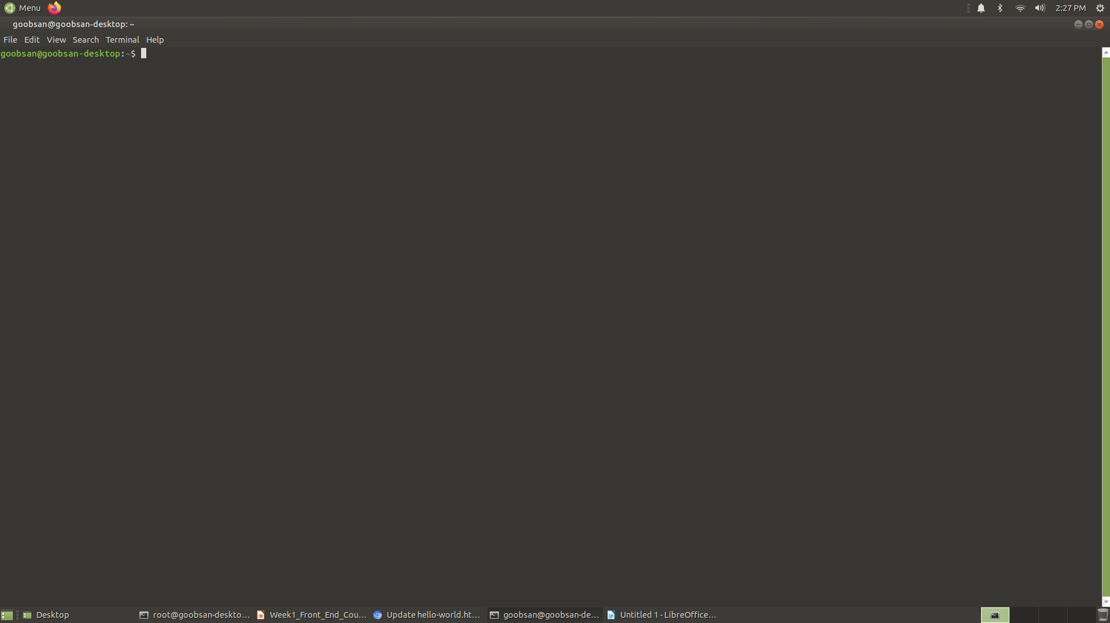

Slide 9
Most Frequent Terminal Commands
See current location: The first command on our journey will be pwd, which prints your current location to the screen. It stands for "print working directory".
List out contents of folder: Now that we know which folder we are in, let's see what's inside of the folder. The next command we will learn is ls, which lists all the content of a folder (ls stands for "list"). When I type it on my computer, I see a list of all files and directories in that folder.
Change folders : When we’re file explore and we want to move to a different folder, we find the icon for the folder where we want to go and double-click on it. In Terminal, we use the command $ cd folder-name (replacing folder-name with the name of the folder to which you'd like to navigate). cd stands for "change directory". Be sure to always type a space after any command that has an additional argument, such as the name of a directory

Slide 10
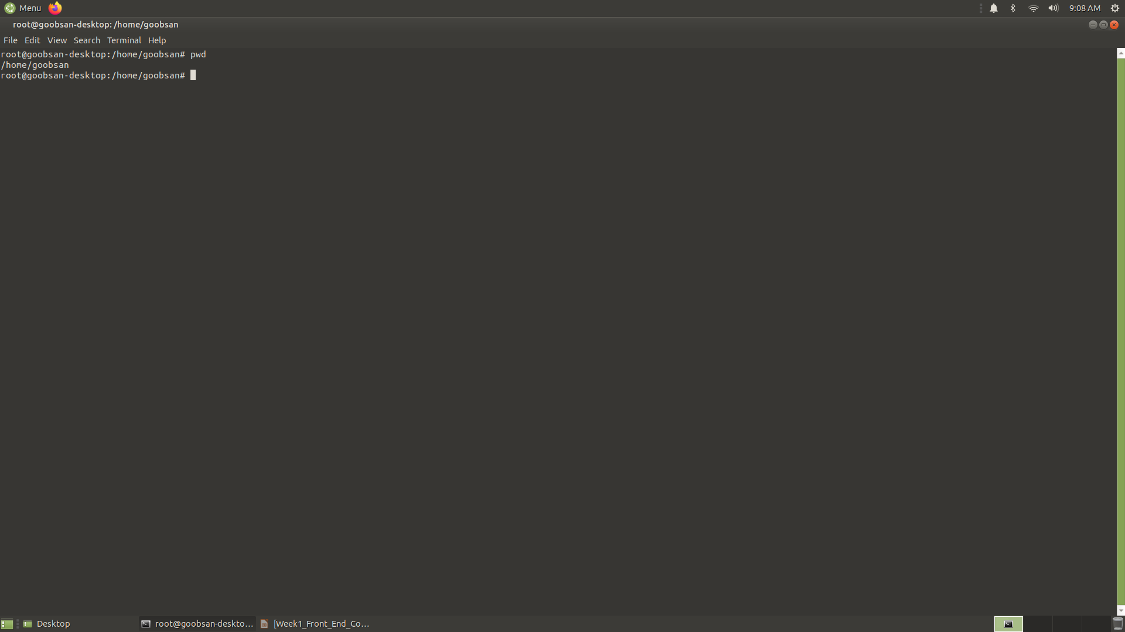

Slide 11
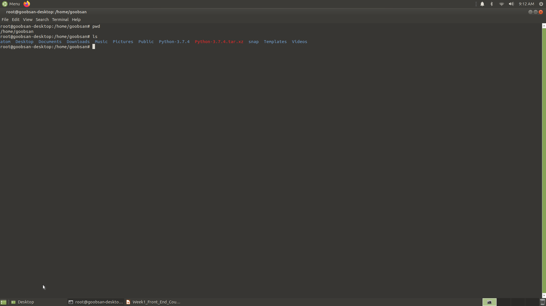

Slide 12
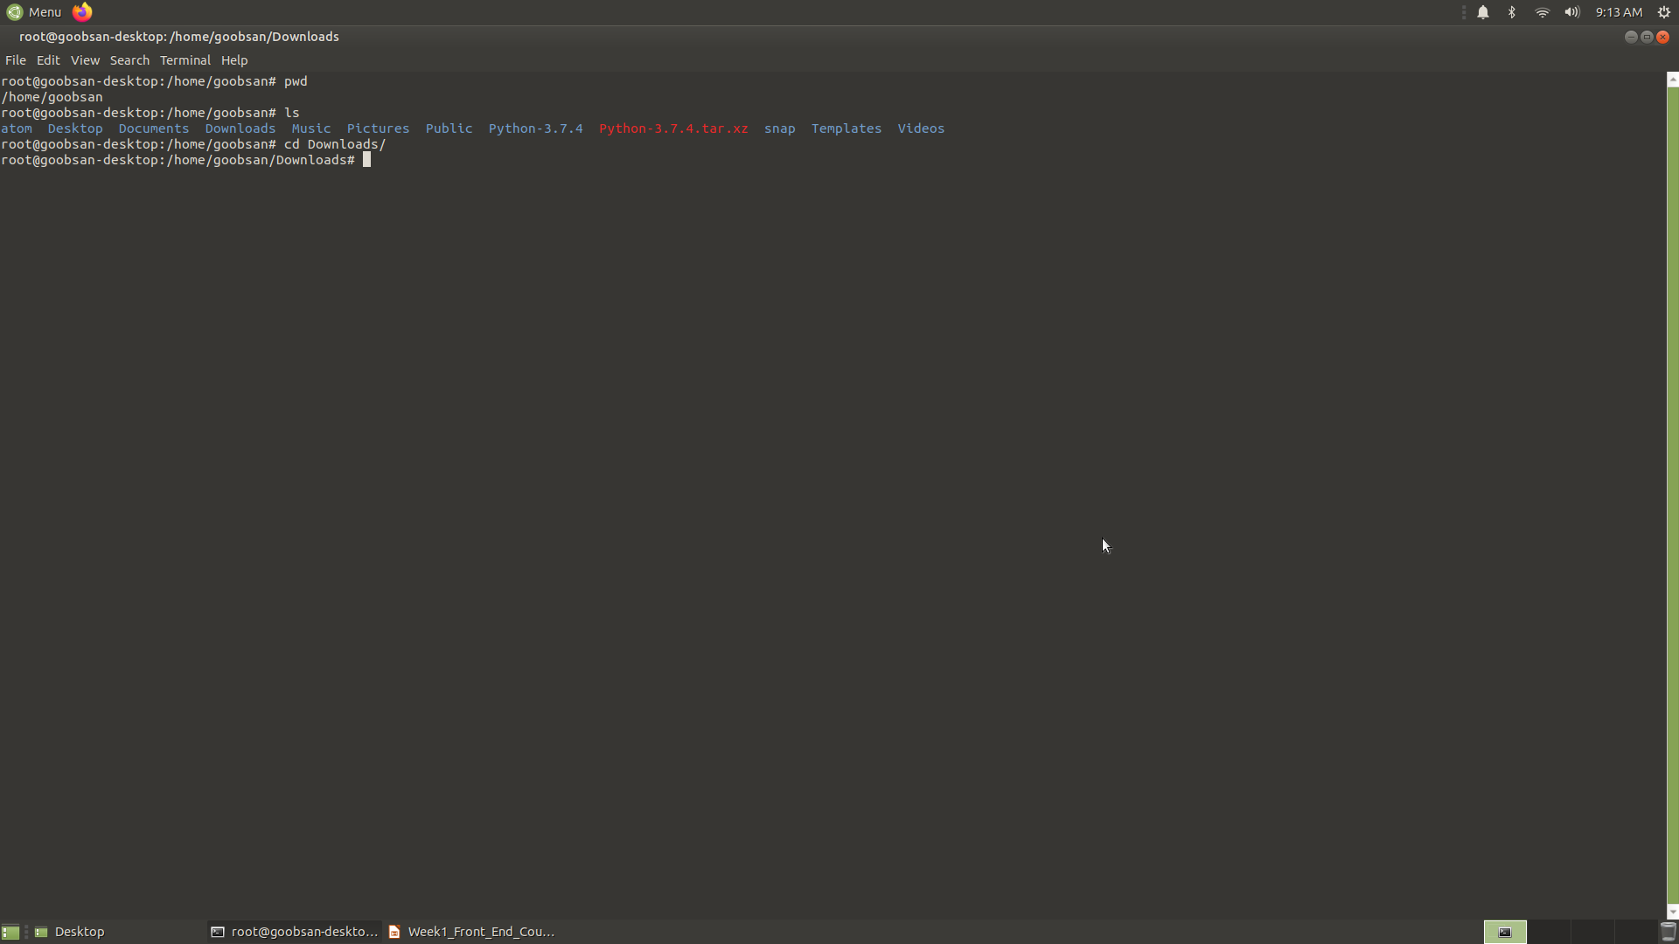

Slide 13
Continue…
Create folders: The command mkdir stands for "make directory". We create a folder with a command like $ mkdir name-of-directory, replacing name-of-directory with whatever we would like to name the folder.
Create new files: The touch command works a lot like mkdir, but instead of creating a new directory, it creates a new file.
Copy items: The command cp stands for "copy", and it is used to copy files and directories. The basic structure of this command is $ cp original-file new-file, where original-file is the name of the original file, and new-file is what you want to name the copy.

Slide 14
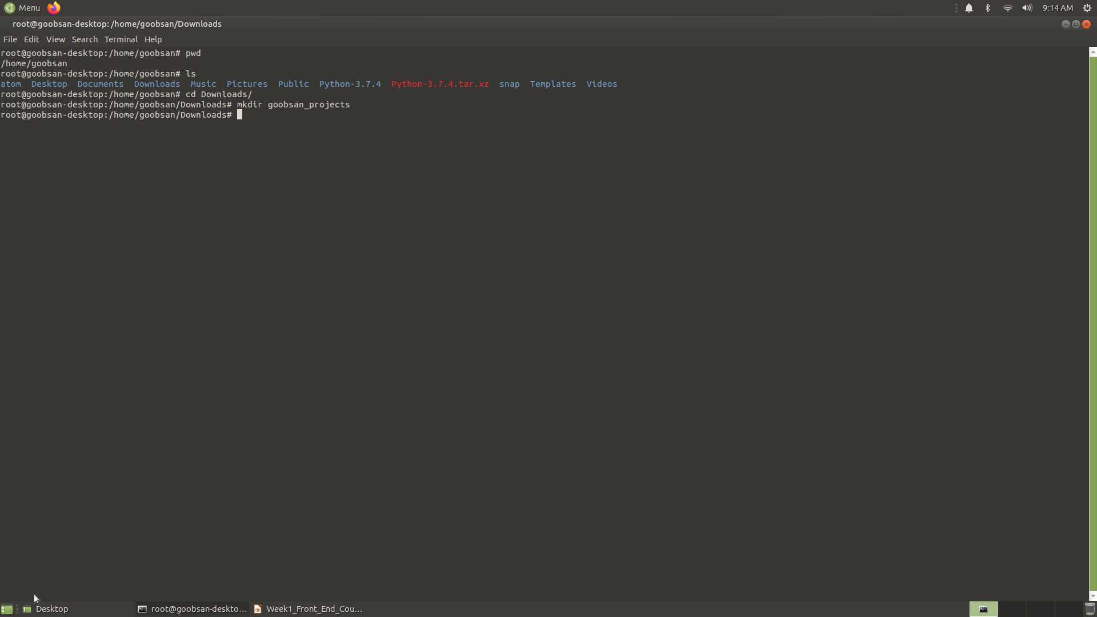

Slide 15
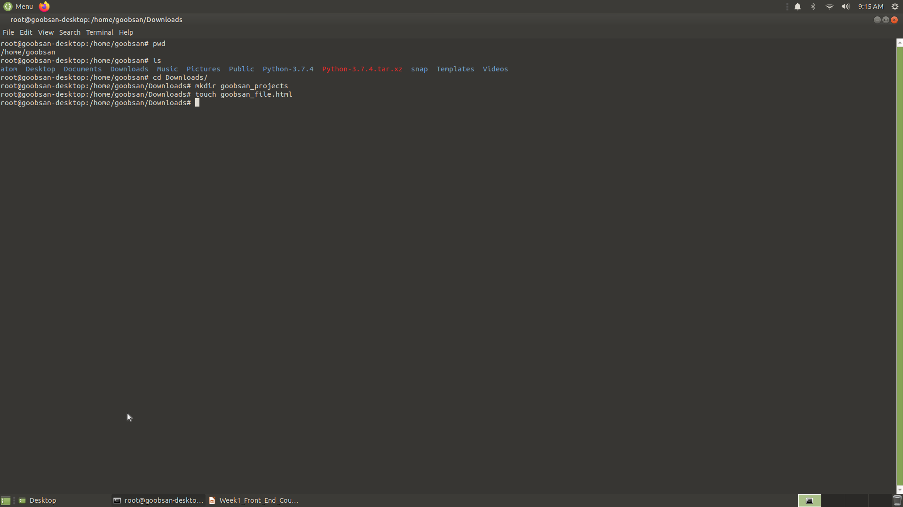

Slide 17
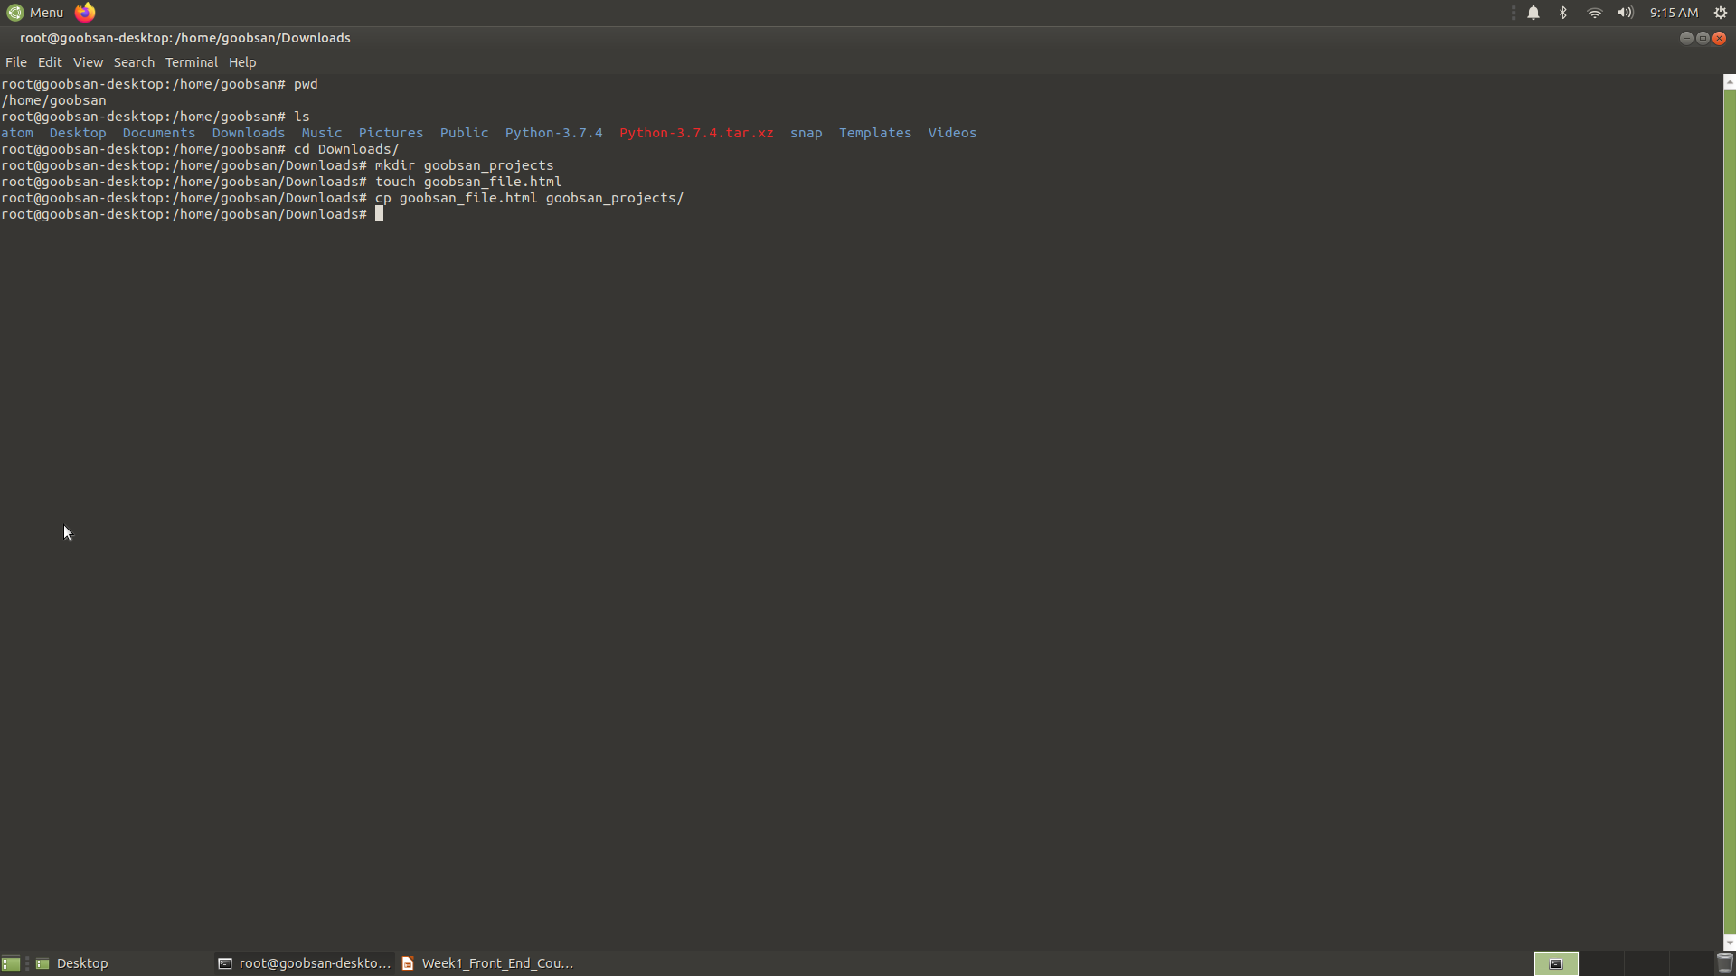

Slide 18
Continue…
Move and rename items: The $ mv command stands for "move". It can both move and rename files. To see how this works, let's list the contents of our current directory
Delete files: We can delete files using the $ rm command.
Clear the terminal screen: Finally, our terminal screen is getting pretty crowded with all of these commands! Sometimes it's nice to start with a blank screen. To clear the screen from previous commands, we use the command $ clear.

Slide 19
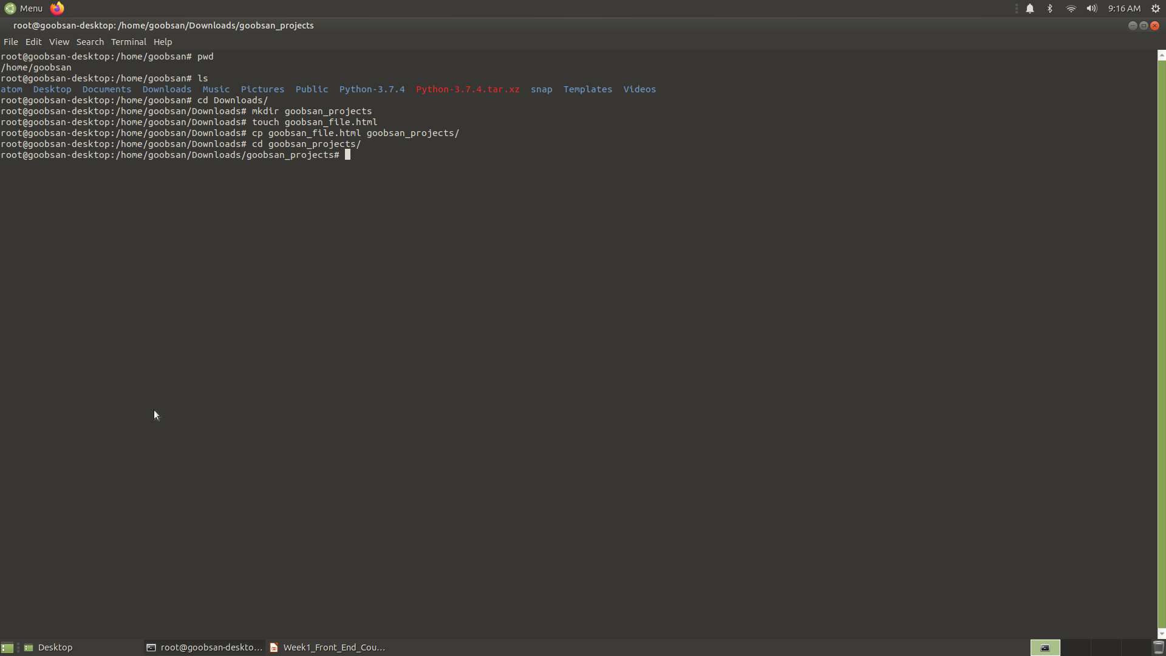

Slide 20
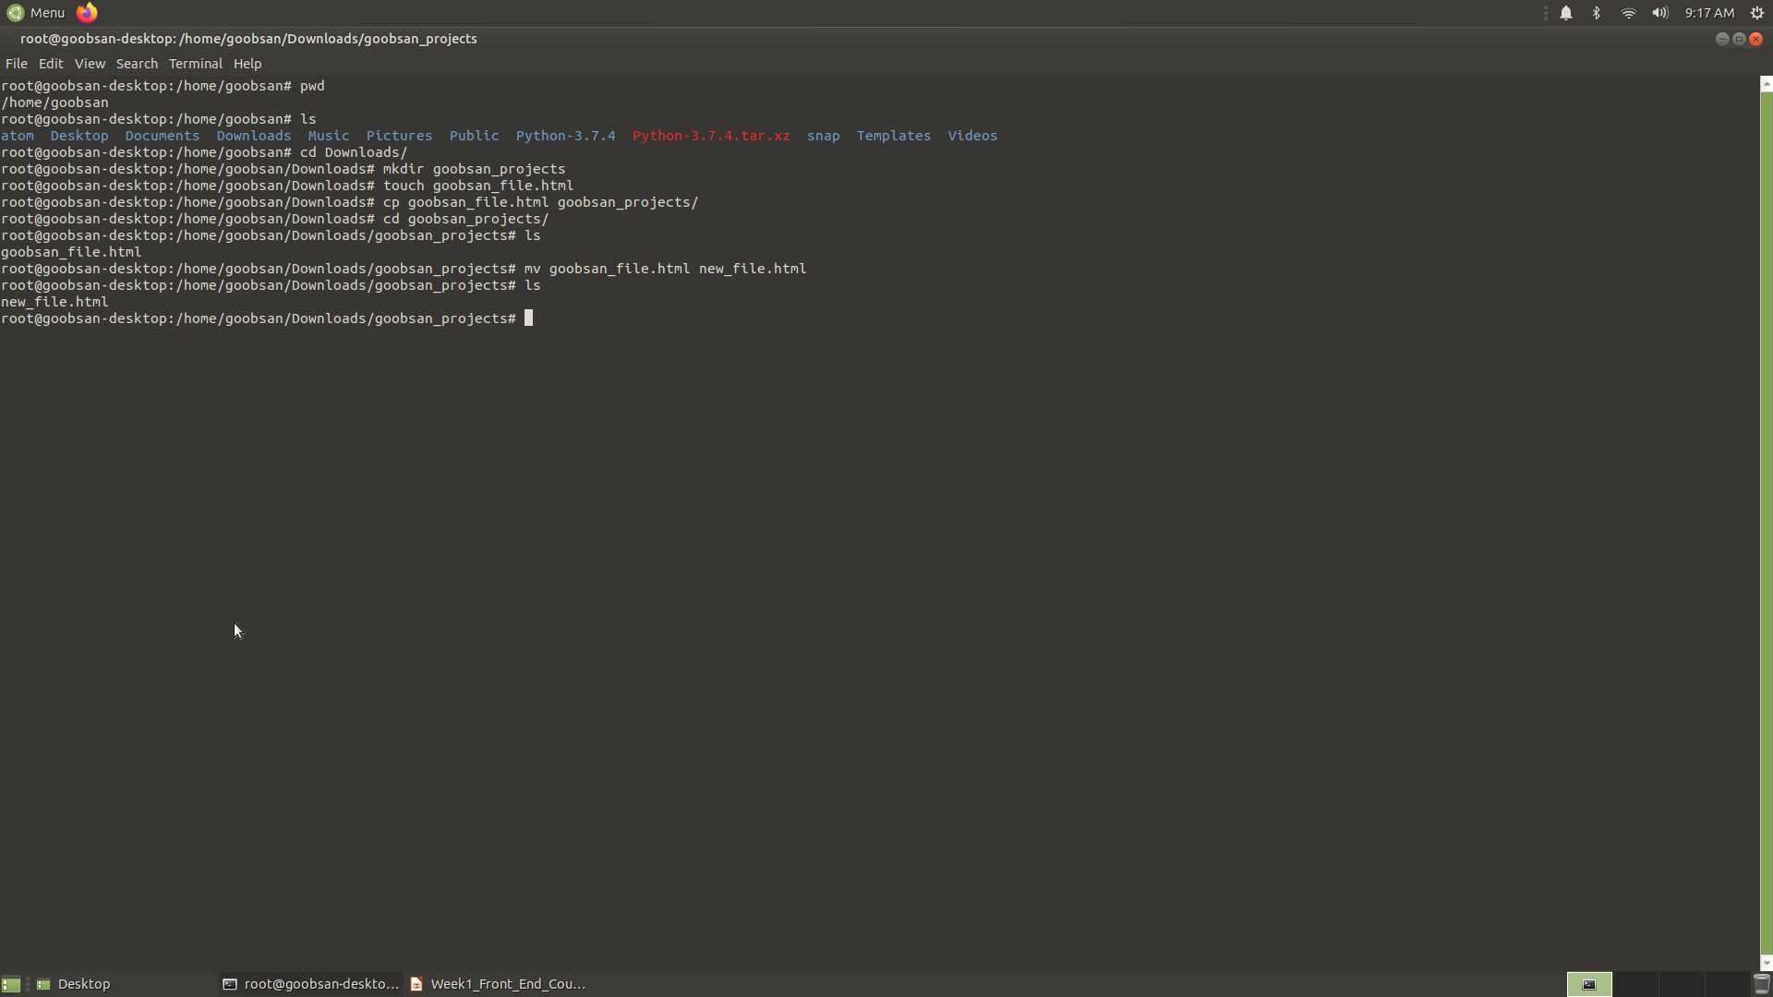

Slide 21
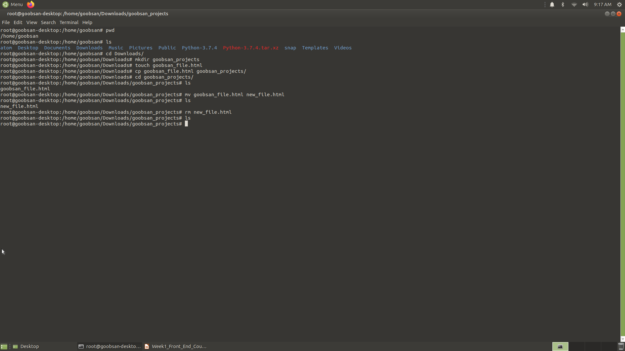

Slide 22
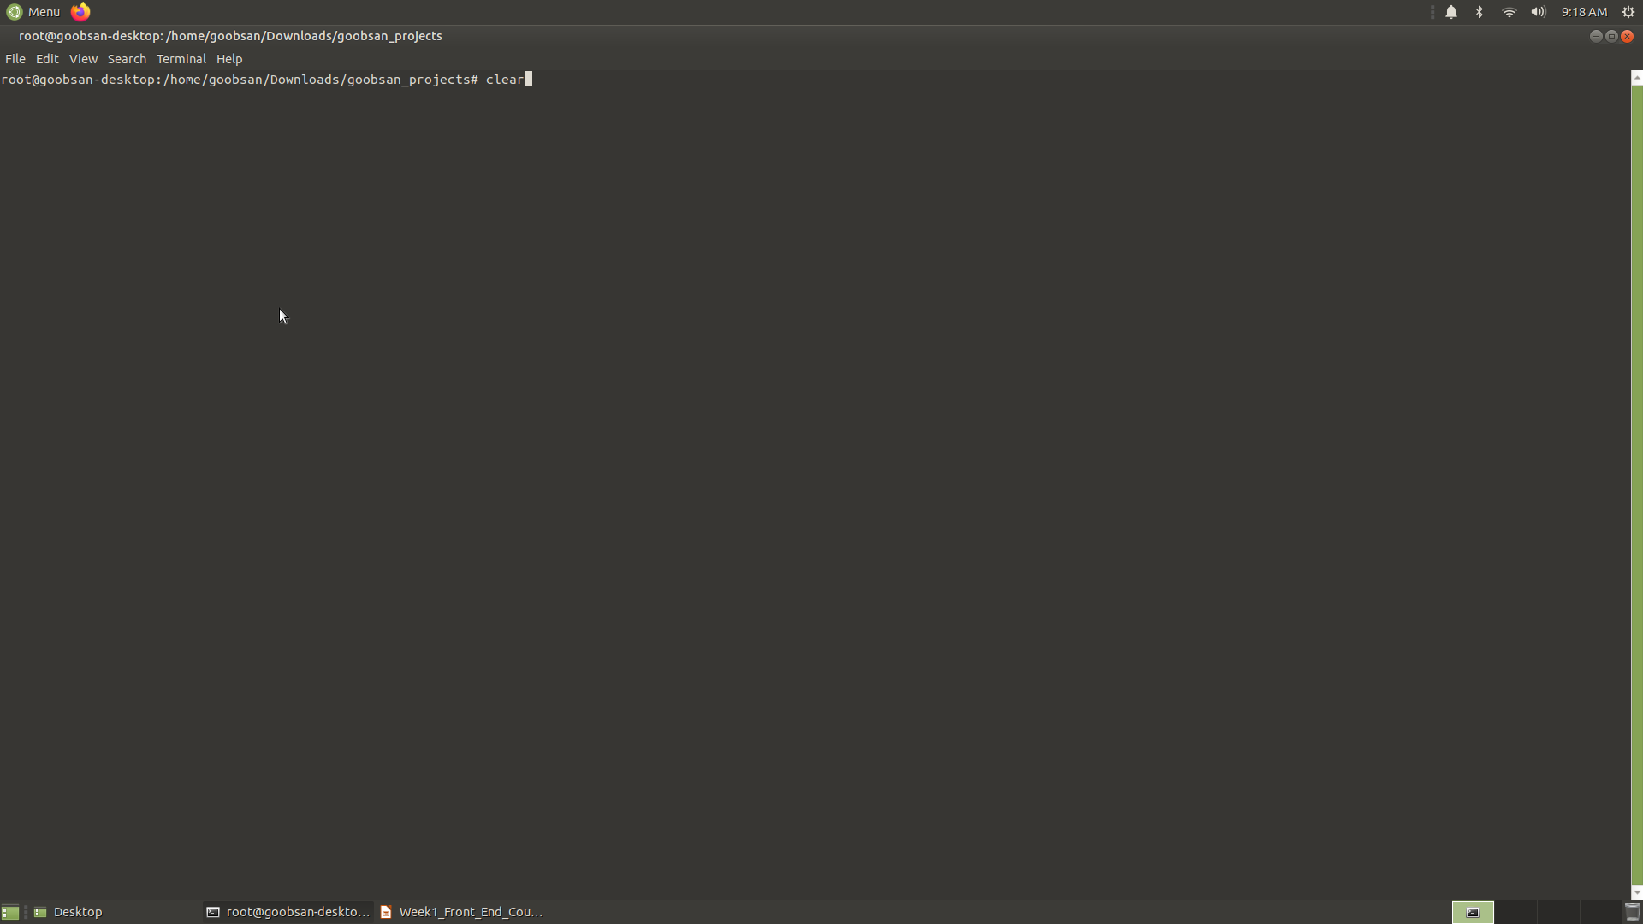

Slide 23
Practice the Command Line
Discuss the following question
What is the difference between a GUI and the command line?
What are some advantages you can think of for using the command line?
Name two commands and what they do.

Slide 24
Code
complete the following exercise in the terminal.
If you're not already there, navigate to the home directory.
Print your location to the screen to make sure you're in the right spot.
List the contents of the Home directory to the terminal.
Navigate to the Desktop directory.
Create a directory named test.
Navigate to the test directory.
Create a file named file1.html.

Slide 25
Continue…
Create two more files named file2.html and file3.html. (Here's a tip: you can create two files with a single command! Simply separate the two file names with a space: $ touch file2.html file3.html)
Create a directory named first-directory.
Move file1.html into first-directory.
Copy file2.html and name the copy file4.html.
Rename file3.html to third-file.html.
Navigate into first-directory.
Delete file1.html.
Navigate up one directory so that you are back in test.
Print your location to verify that you are back in test.
Delete first-directory.
List the contents to the page to make sure that first-directory was successfully deleted.
Clear the terminal screen.

Slide 26
ATOM AND GIT
In this section, we are going to walk through creating our first webpage in the Atom text editor and tracking the process using Git. Make sure you have installed both of these on your computer before we begin

Slide 27
ATOM
Let's take a quick tour of Atom. Open the program. When we open the editor, we arrive on an empty file with the name "untitled". If we add content to the file, we see the x at the top becomes a blue circle. This indicates that there is content that hasn't yet been saved. We'll save this file as my-first-webpage.html using the .html extension to indicate that this will be a document written in HTML. The blue circle returns to a grey x and we know that our file's content has been saved.
Atom offers developers the ability to customize the editor's settings and shortcuts. Press Ctrl + , (Ubuntu and Windows) to see the Settings view.
One setting that we want to make sure we have in place is the tab length. Writing good code means making a habit of using consistent indentation. The standard for indenting lines of code is 2 spaces. We have confirmed that this is set to 2. So, rather than hitting the space bar twice, we can use the tab key for indentation.

Slide 28
GIT
We've already started using command line to navigate our computer. Let's switch gears a little and expand on what we're able to do using the command line and start using Git and GitHub. In this lesson, we will create a simple webpage and track the process using Git.
Tracking changes with Git
Every project that we create will have its own directory (a folder in your laptop) and its own repository (a folder on Github). Now we are going to walk through creating a new project and tracking those changes with Git.
The first thing we need to do is create the project directory on our own computers. We'll do this just like we have done previously - Git will come in shortly. Open up Terminal and navigate to the folder where you would like to create your projects.
I am going to create a new folder named goobsan-projects inside of my computer's Documents directory to hold all of the projects that I will create in class.

Slide 29
Continue..
Now we are located in our goobsan-projects directory, and we can add a new directory for this project. I am going to call this one hello-world (and just a bit of computer programming history for you: it's traditional to write some form of hello world as the first program or example you write in a new language).
$ mkdir hello-world $ cd hello-world

Slide 30
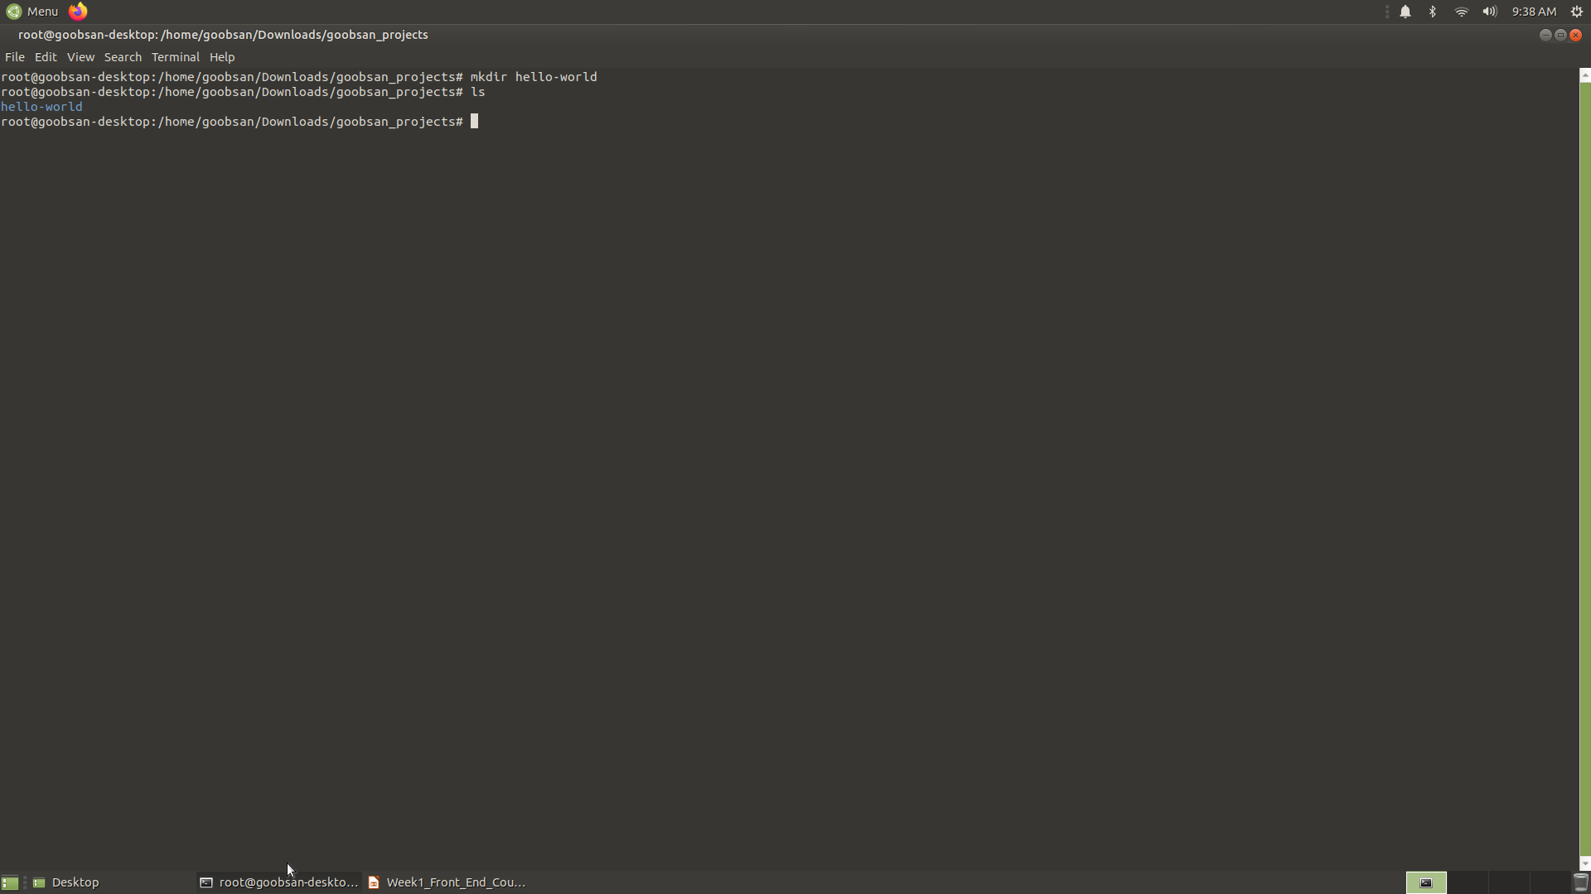

Slide 31
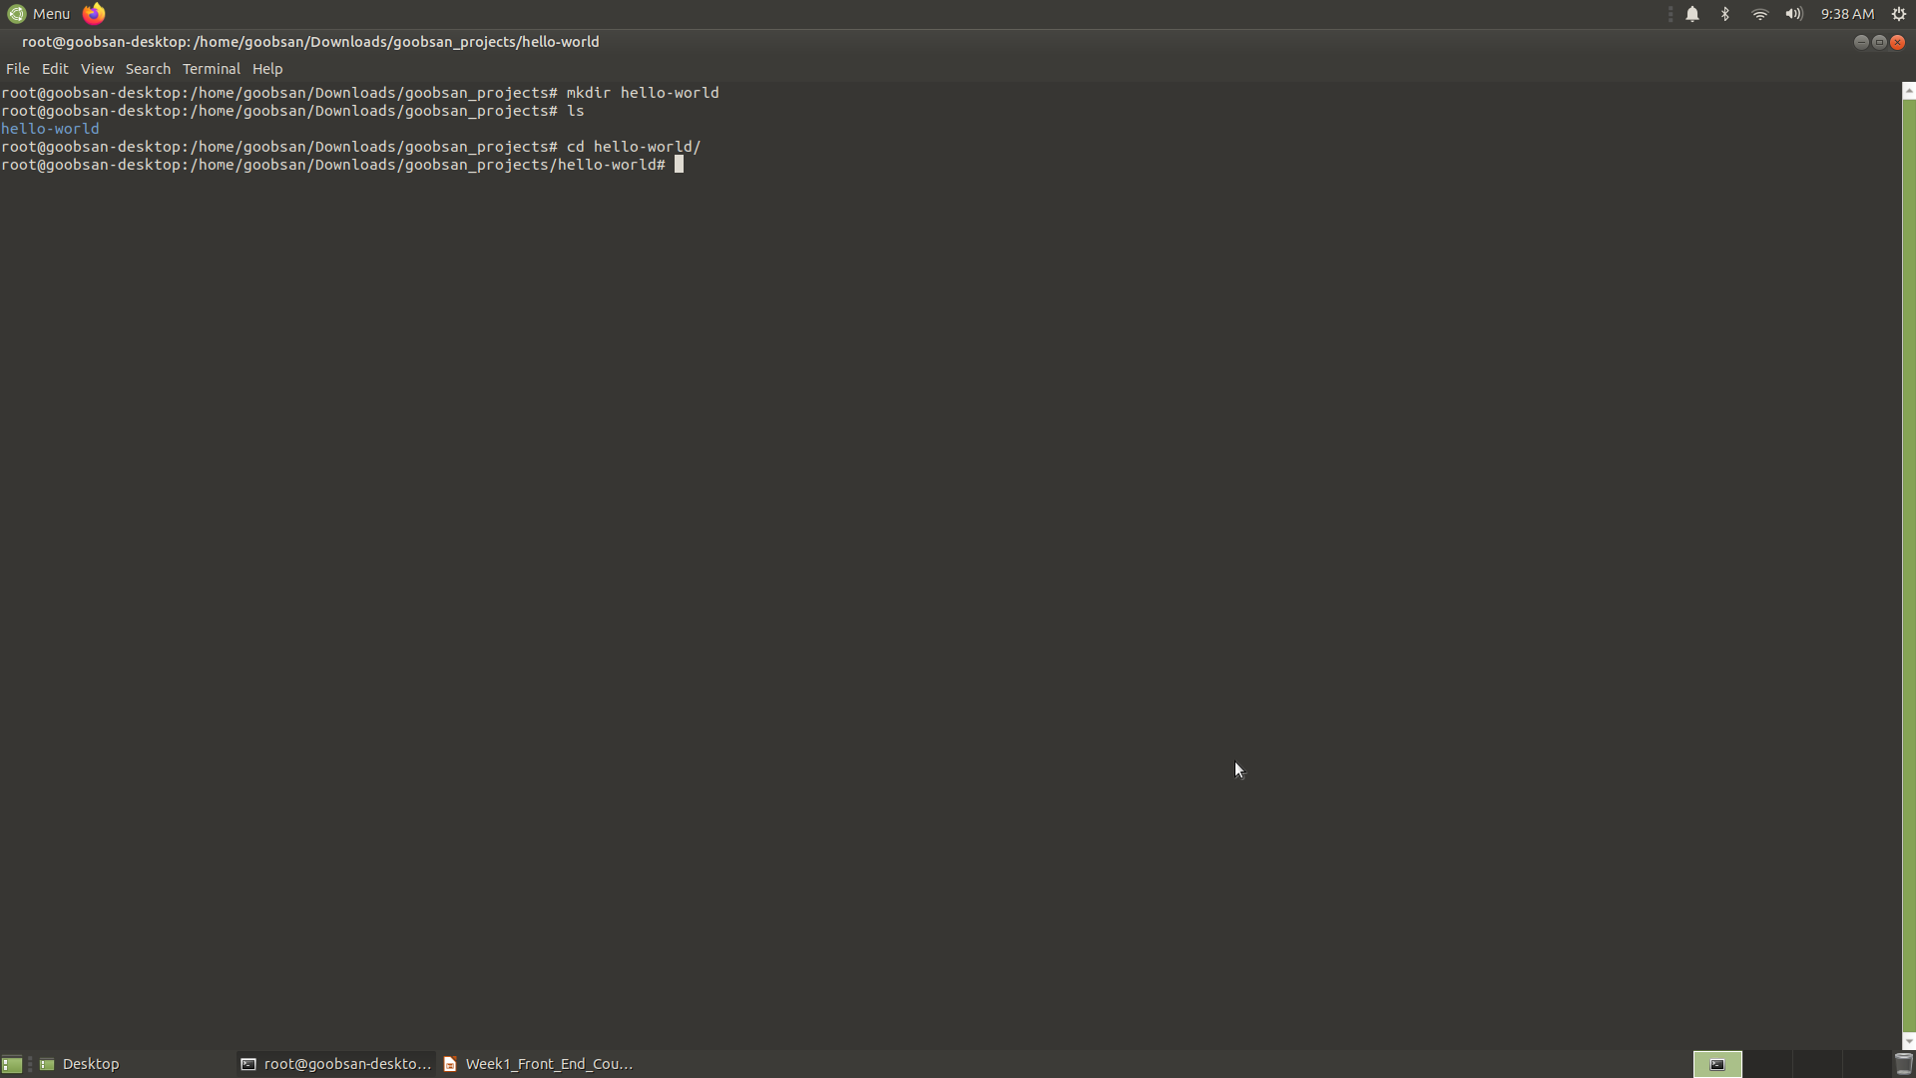

Slide 32
Continue..
Now we are located inside of our new hello-world directory, and we can turn it into a Git repository. We do this by initializing Git inside of the directory (make sure that you do this inside of the hello-world directory! Remember, you can always see your location with $ pwd):
$ git init
Initialized empty Git repository in /Documents/moringa-school-projects/hello-world/.git/
As the confirmation message reads, the Git repository has been initialized inside of a directory named .git. But when we try to list the contents of hello-world) with $ ls, where is it?
Directories that being with . are hidden directories, which means that they do not show up with the $ ls command. To view hidden files, we need to use the -a option like this, which stands for "all":
$ ls -a
.git

Slide 33
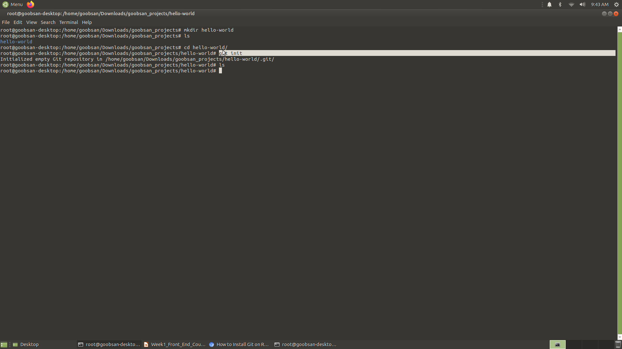

Slide 34
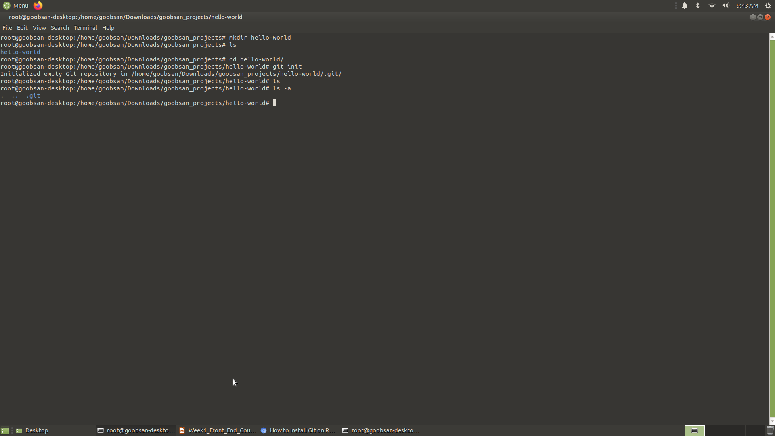

Slide 35
Continue..
The .git directory is where all of the changes we make to our project will be tracked. Whenever we add, edit, or delete files, Git will be keeping track of those changes in here. This is actually why the .git directory is hidden in the first place
Create an empty file in the project directory named hello-world.html:
$ touch hello-world.html
Now open the project in Atom using the following command:
$ atom .
The $ atom command tells the computer to open anything that follows it in Atom. The . means current directory, so the entire directory should open up in Atom.

Slide 36
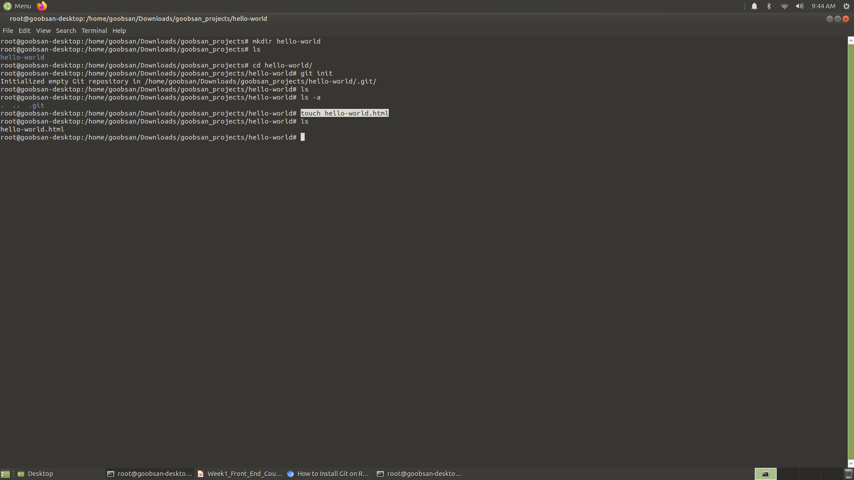

Slide 37
Continue..
We can see what Git is doing with our files with $ git status:
a commit is a record of what files you have changed since the last time you made a commit. A commit is like a save point, and we want to make a commit when we've made a notable change or addition to a project. Commits narrate the development of a project and allow you to go back to the state of a project at any point.
So, how do you tell Git which files to put into a commit? This is where the staging environment comes in. As we just saw, when you make changes to a repo, Git notices that a file has changed but won't do anything with it.
To add a file to a commit, we first need to add it to the staging environment. To do this, we can use the $ git add <filename> command. Here is how we add hello-world.html:
$ git add hello-world.html or git add .

Slide 38
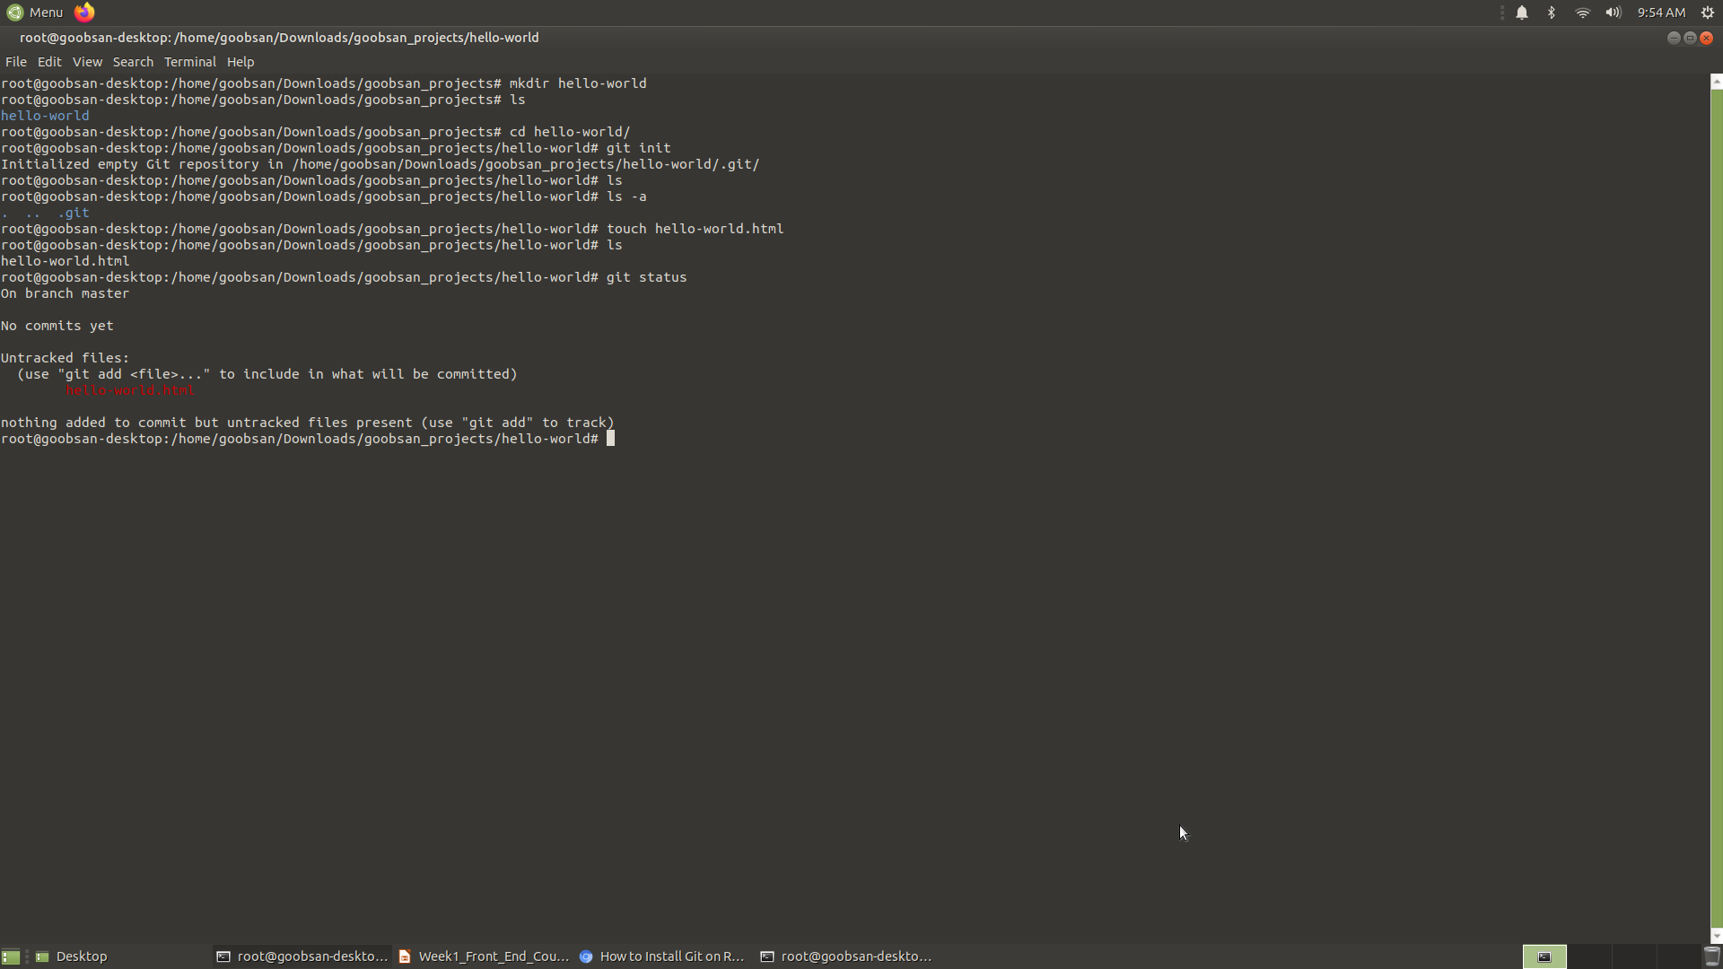

Slide 39
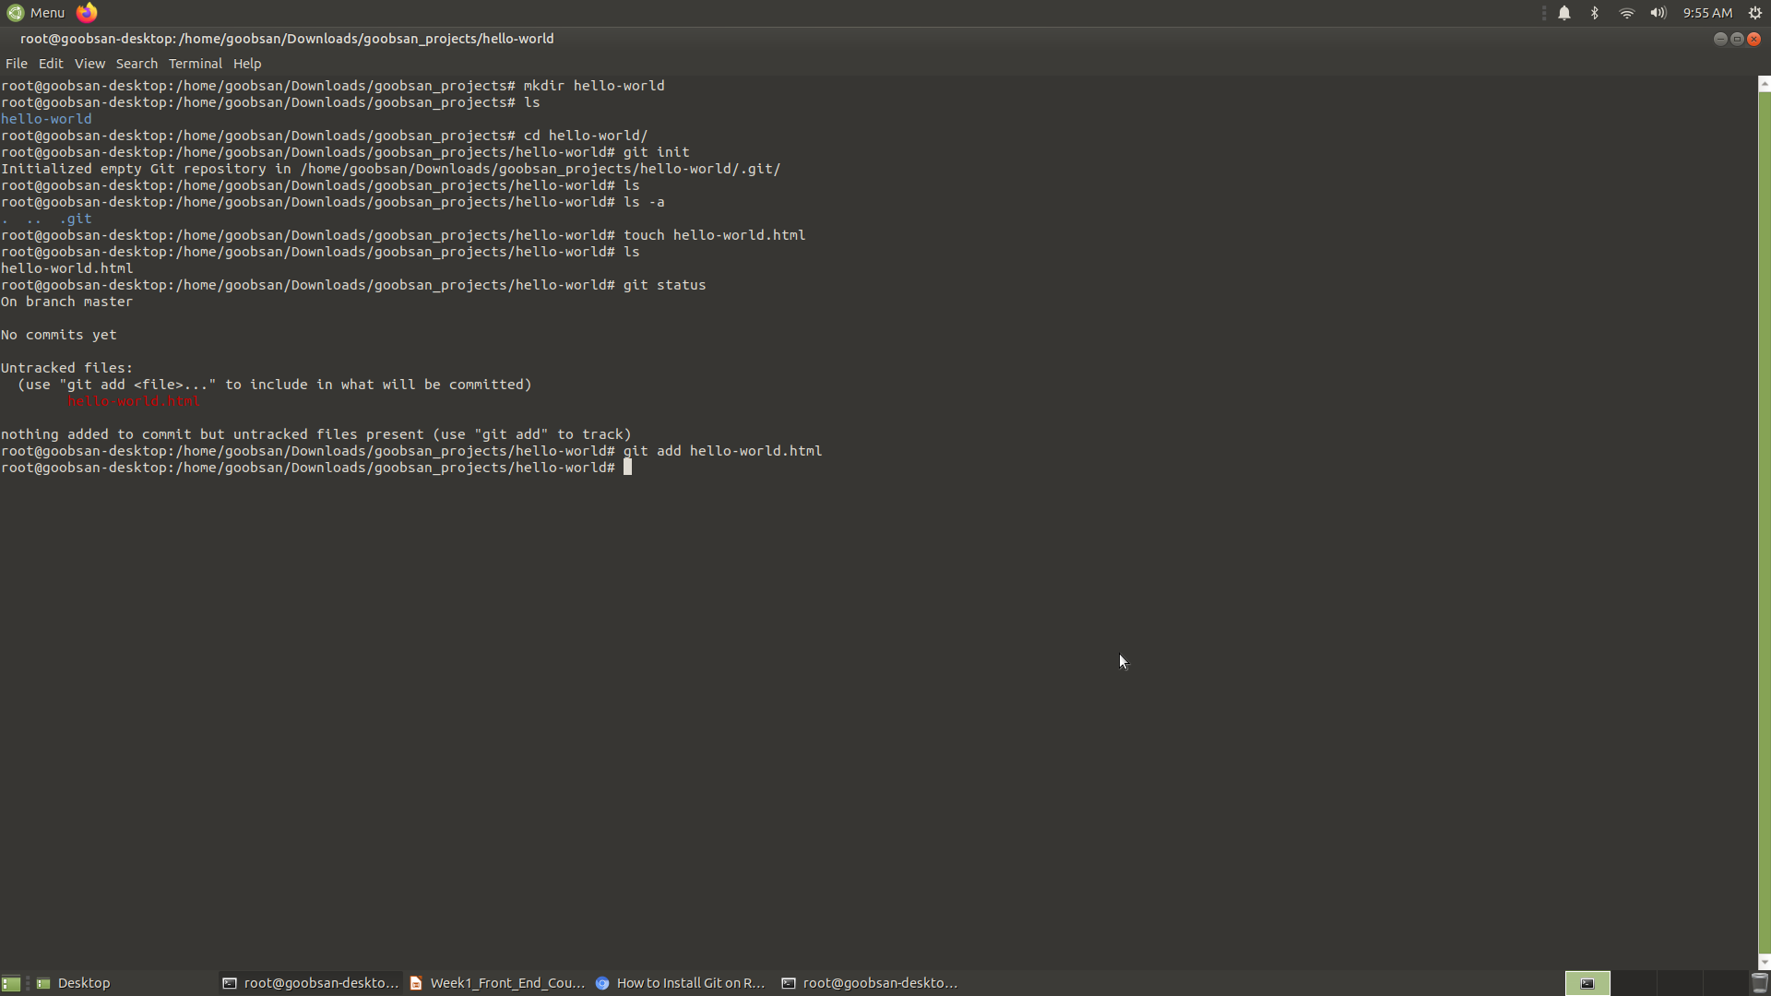

Slide 40
Continue..
Once you've used the git add command to add all the files you went to the staging environment, you can then tell Git to package them into a commit using the git commit command. Let's do that now.
$ git commit -m "Add initial hello world page”
To make a commit, we use the git commit command followed by the -m option (for "message"), followed by a short message describing the commit.
For consistency, commit messages should be in present tense and describe the change(s) made. As a rule of thumb, they should complete the phrase, "This commit will...". So when we look back at our commit history, we know that this commit will "add initial hello world page".
We can look at our Git commit history with the git log command:
$ git log and make this a little easier to read by adding the --oneline
$ git log --oneline

Slide 41
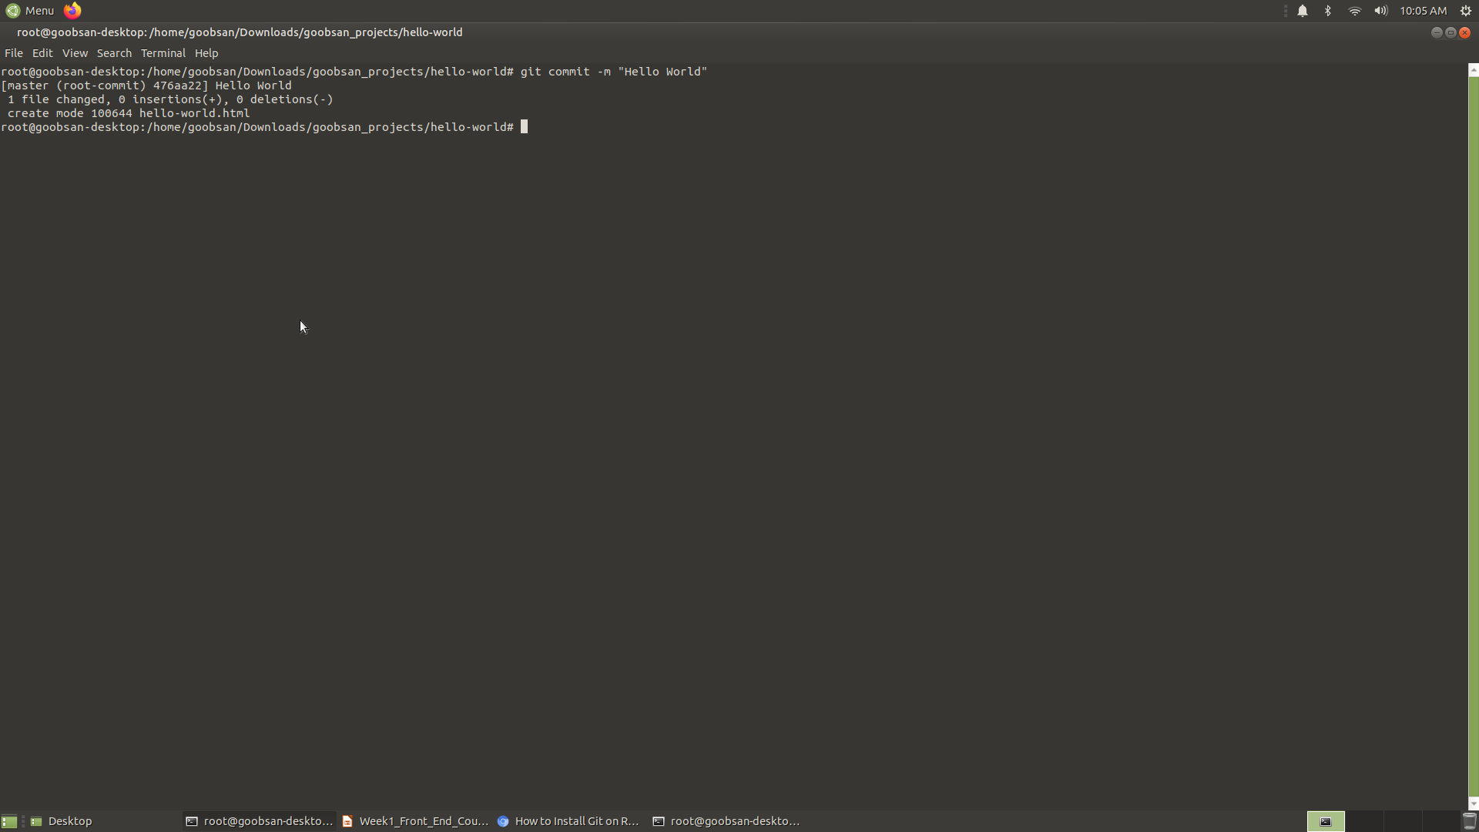

Slide 42
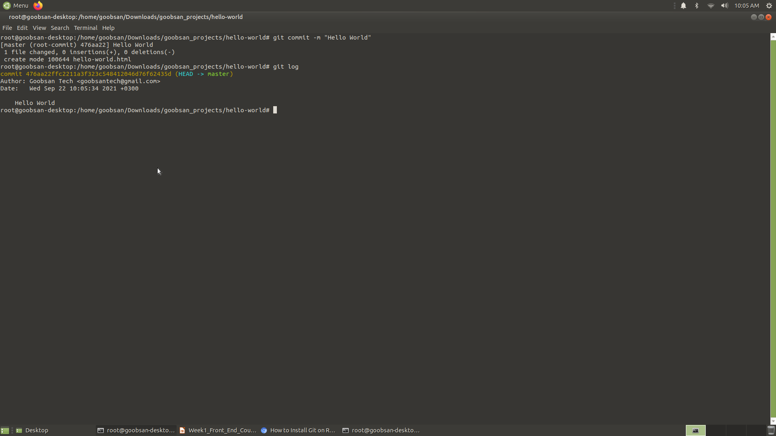

Slide 43
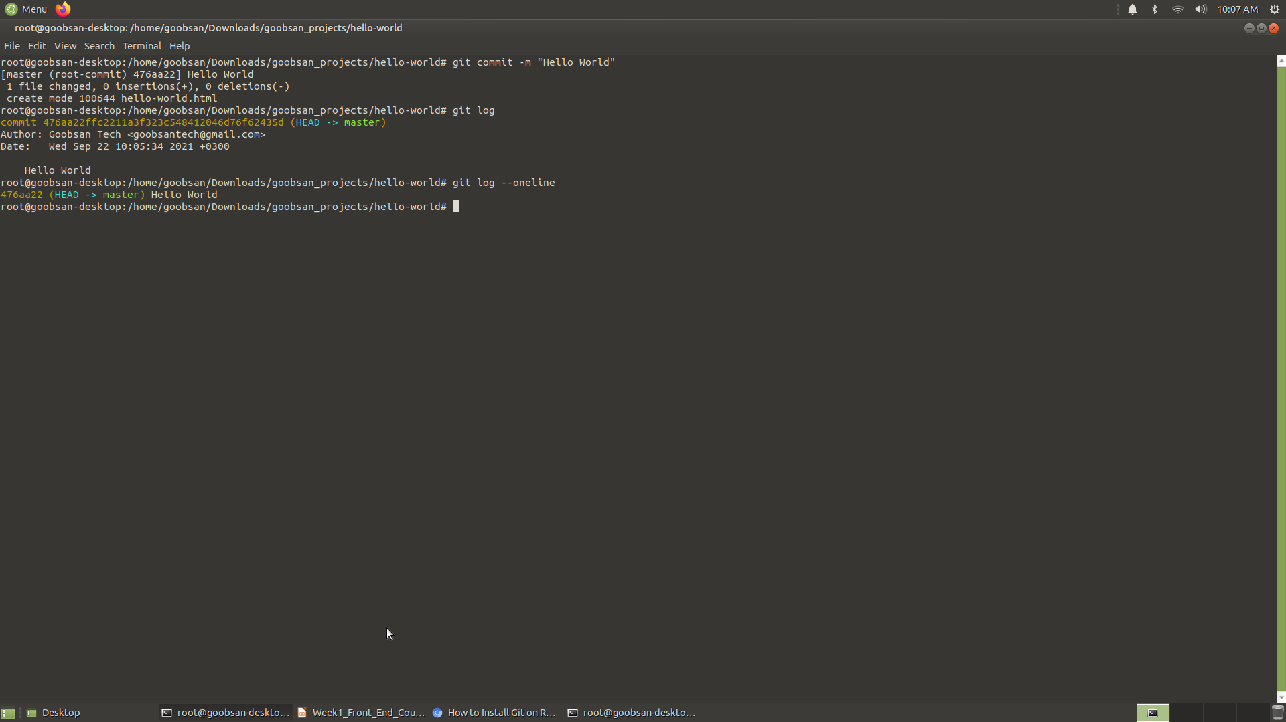

Slide 44
Remote repositories on GitHub
So far, our code only exists on the machines where they were written. We have been tracking our changes in a local Git repository, which is the .git directory we've seen. However, it would be good to have a copy of our work backed up online, especially when our projects grow in size and have real-world implications. More importantly, we will need some way of collaborating with others on our work. When we want to push our work to the world, we will push it to a remote repository on GitHub. In this Section, we will explore GitHub and how to use it.

Slide 45
Continue..
What do we mean when we say local and remote? When we work on a repository that we can only access from the computer on which it is saved, we call this a local repository. All the code we have written so far has been written locally. If we want to work on the project from another device, we won't be able to access it. A remote repository, on the other hand, is a repository that is saved in a location outside of the computer where it was created, but still accessible by that computer (and other computers as well). At Moringa School, we will generally be saving our work to remote repositories.

Slide 46
Continue..
Let's start by pushing our local repository to a remote repository on GitHub.
The first thing we need to do is create the remote repository on GitHub. Each partner needs to create a repository on their own GitHub account. Both remote repositories will link to the same local repository, but this will give each of you a personal record of the project.
Once you're logged in, click the New Repository button,
After New Repository is created
With this empty repository in place, we can push our locally-stored code to the new remote location.
First, we need to tell our local repository that a remote repository even exists somewhere online. We do this by adding it to Git's record. Just like Git wouldn't do anything with our files until we used git add, it won't acknowledge our remote repository yet, either.
To tell the repository about the remote location, we use the git remote add command like this:
$ git remote add origin https://github.com/goobsan/hello-world.git

Slide 47
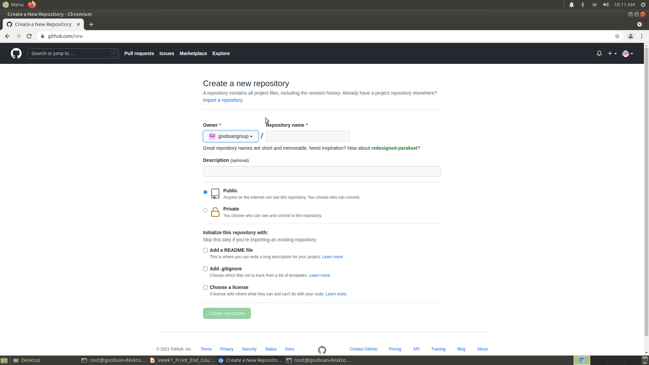

Slide 48
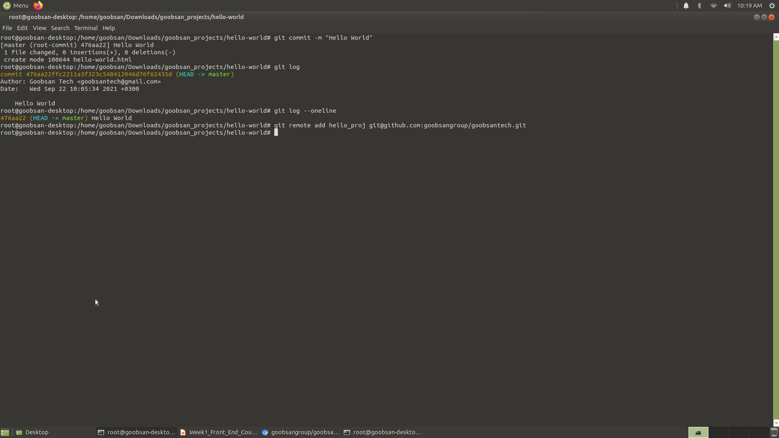

Slide 49
Continue..
Now Git knows that there is a remote repository, and it's where you want your local repository changes to go. To confirm that Git has done this successfully, run this command:
$ git remote –v
The -v option will give you a list of all of the remote repositories that your local repository knows about. There's one repository and it’s listed twice, which means it is available to push information to and to fetch information from. If both you and your partner have added remote repositories, then both repositories should be listed.
Before Push we will create ssh-keygen for our github account
ssh-keygen -t rsa -b 4096 -C "goobsangroup@gmail.com" eval $(ssh-agent -s) ssh-add /root/.ssh/id_rsa.pub cat /Users/hafsasaidali/.ssh/id_rsa.pub
We are finally ready to push our code from local to remote. In other words, we will be copying it from our machine to the location on GitHub. To do this, we will use the git push command:
$ git push origin master

Slide 50
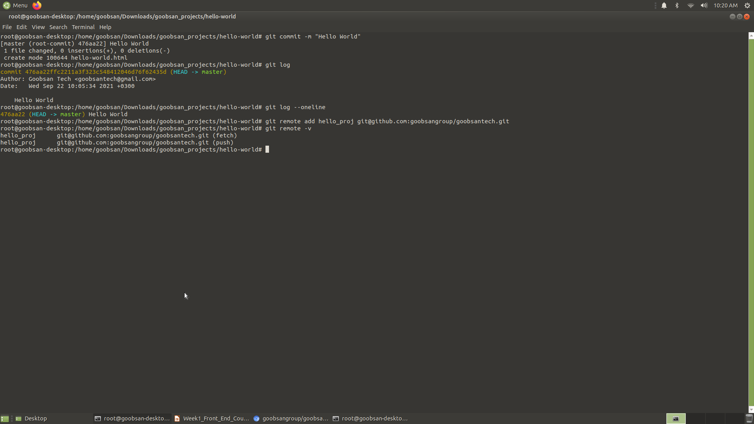

Slide 51
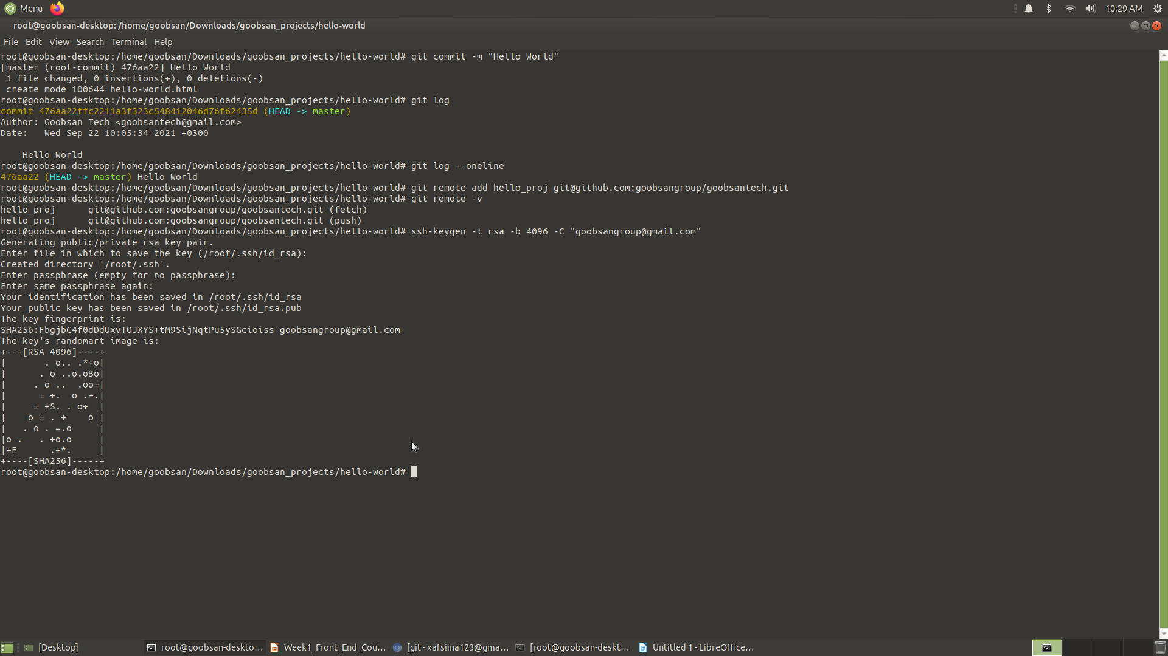

Slide 52
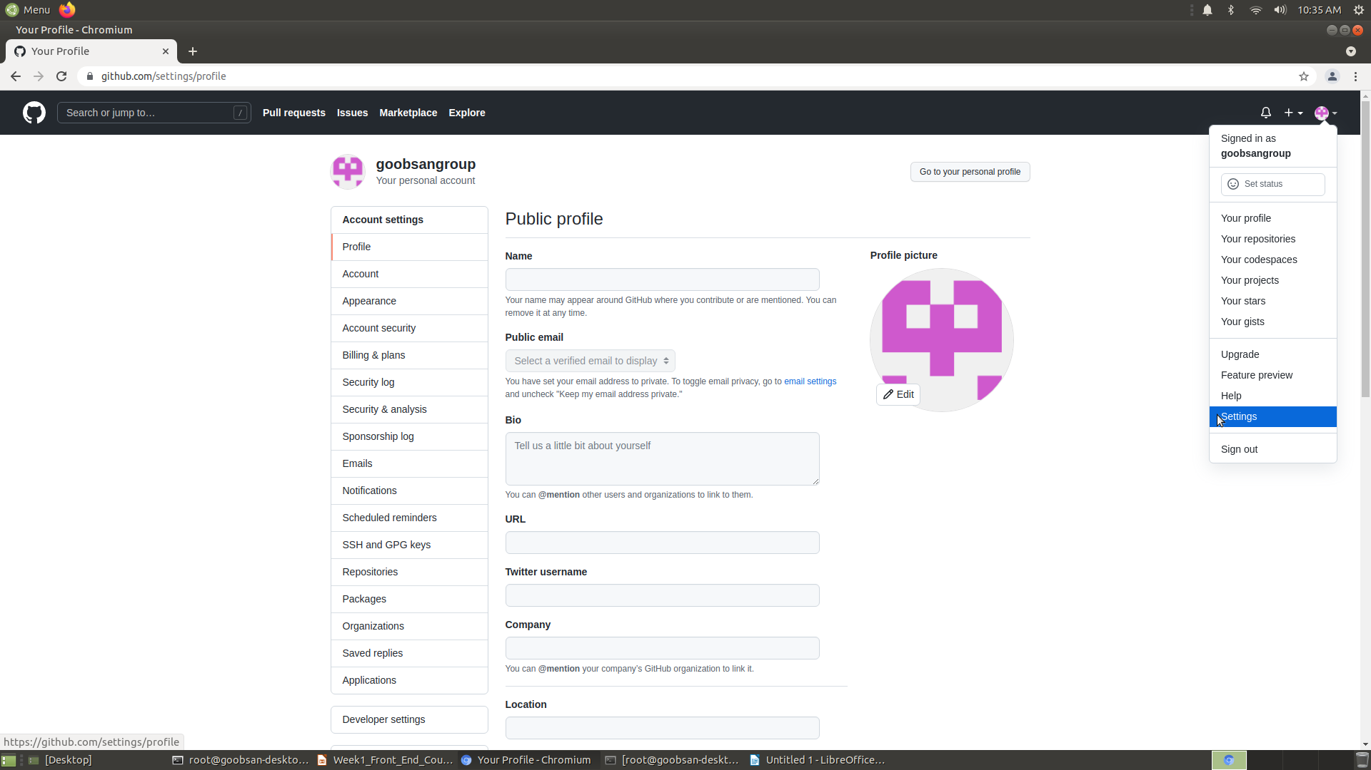

Slide 53
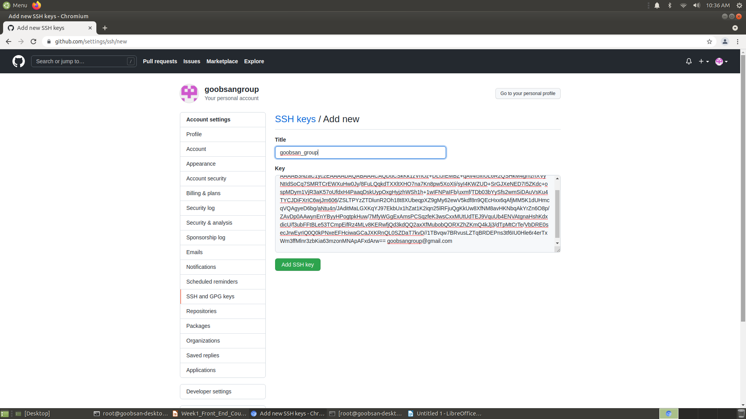

Slide 54
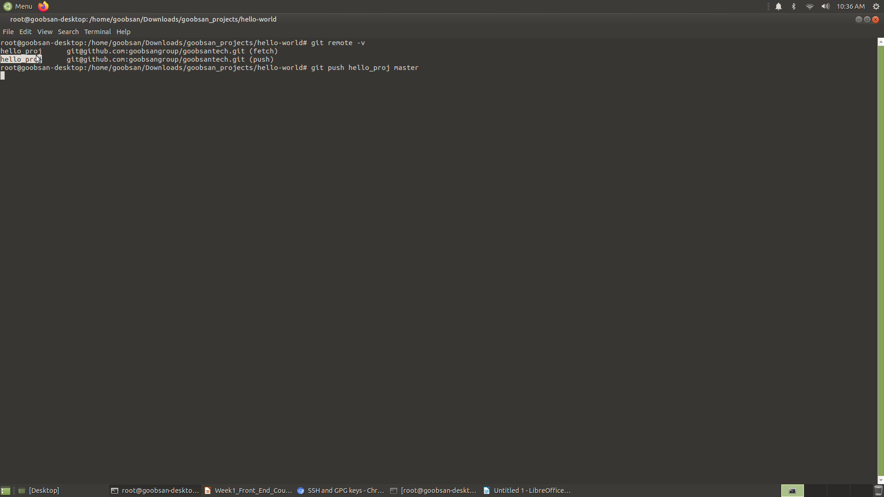

Slide 55
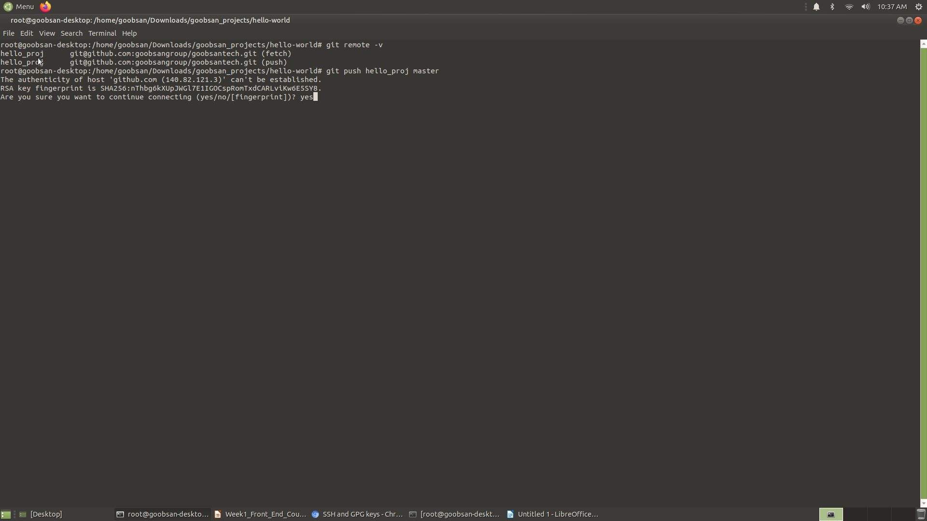

Slide 56
Continue..
When you push to GitHub on a computer where the user has not been set globally, the terminal will prompt you to enter your GitHub login information. This is GitHub protecting your account - only the owner of a repository is allowed to push to it. Once you have entered your login information, the terminal will give you some feedback that it is pushing your code to the remote repository. Go ahead and refresh the repository's page on GitHub, and you can see the file structure of the project, and the same commits that we saw in the terminal.

Slide 57
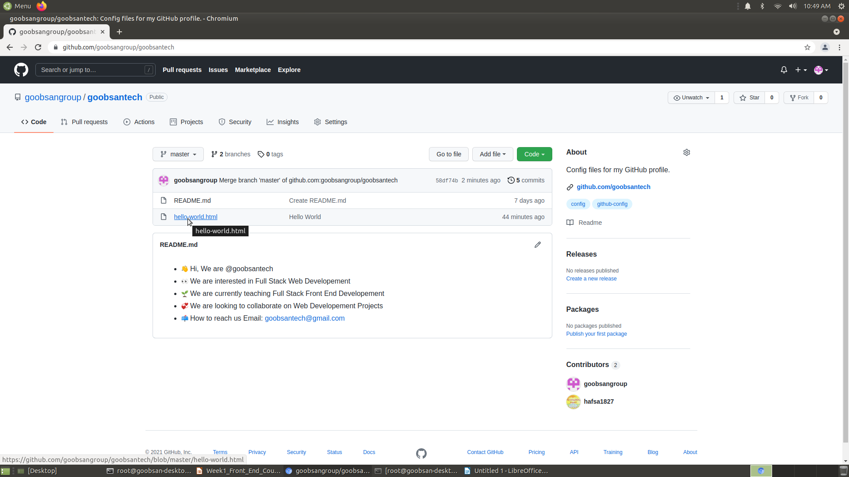

Slide 58
Cloning from GitHub
All right, we've pushed code from our personal machine up to GitHub. But as we mentioned before, one of the big advantages to using a service like GitHub is how it lets us collaborate with others on the same code. This requires copying the code from the remote repository into a local repository, a process called cloning.
To practice this, first, we need to remove the local repository from our personal computers. If you are in the hello-world directory (check with pwd):
$ pwd Documents/goobsan-projects/hello-world Move up one directory with $ cd .. and remove the folder:
$ cd .. $ rm -rf hello-world

Slide 59
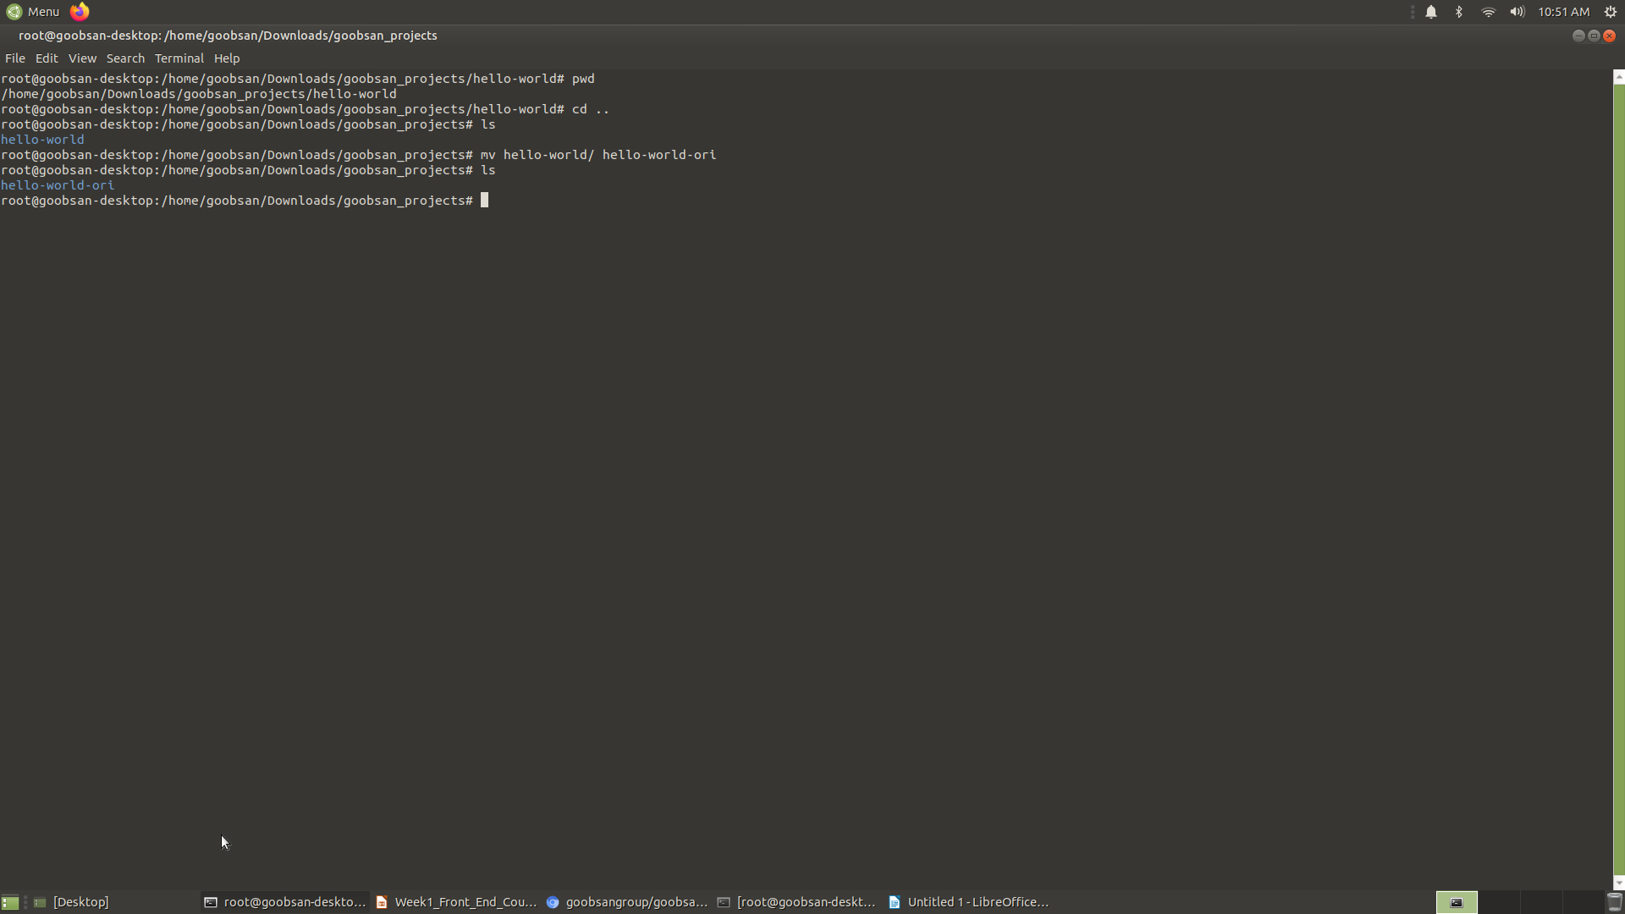

Slide 60
Continue..
Now the folder is gone, and we can clone our remote repository back onto our computers. On the main GitHub page for the repository, find the button that says Clone or download. A dialog box opens containing the URL for the repository. This is the same URL as the one we used for the remote. Copy the URL (either select the text and copy it manually, or click on the clipboard button next to the URL), and we will clone the repository using the git clone command in the terminal:
$ git clone https://github.com/goobsan/hello-world.git
The terminal will print some feedback that it has successfully cloned the repository. Go ahead and list the contents of the folder and see that we now have a hello-world directory:
run git log and git remote -v
origin https://github.com/moringaschool/hello-world.git (fetch)
origin https://github.com/moringaschool/hello-world.git (push) We see that the remote repository is automatically linked, and by default, it has the name origin. If we make changes to our local repository and want to push those to GitHub, we will use the origin remote nickname, like this:
$ git push origin master

Slide 61
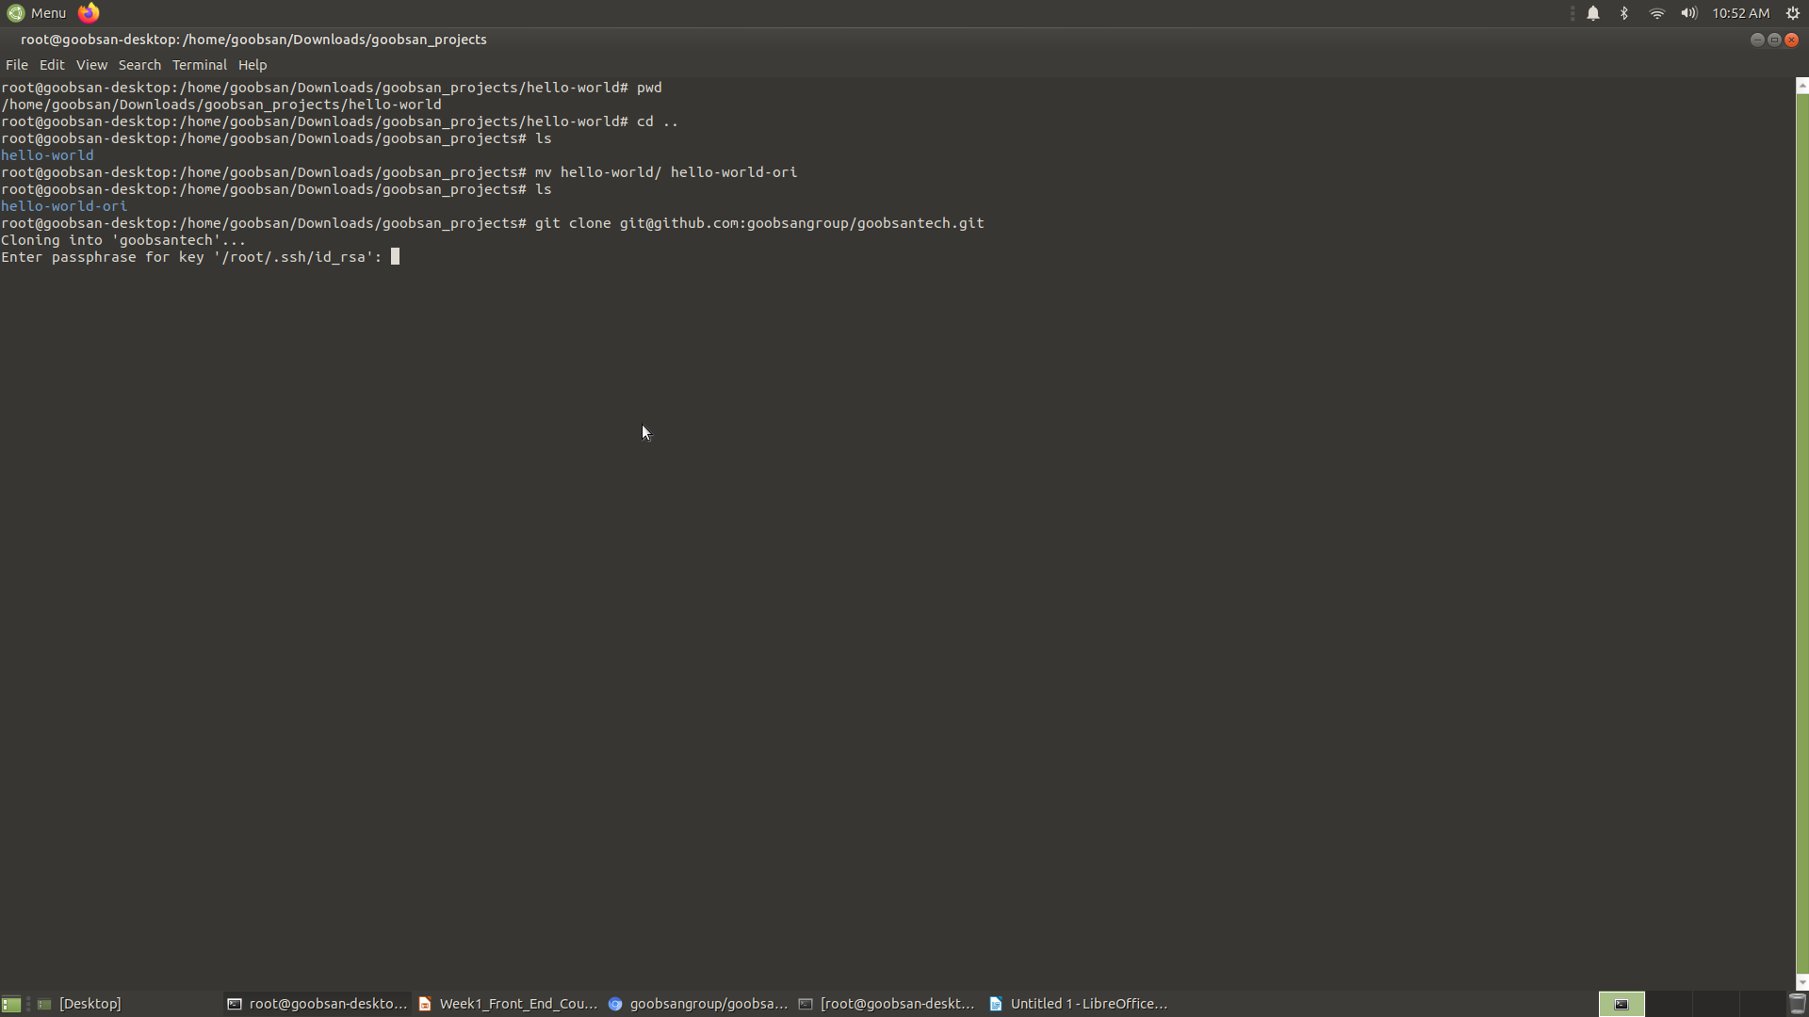

Slide 62
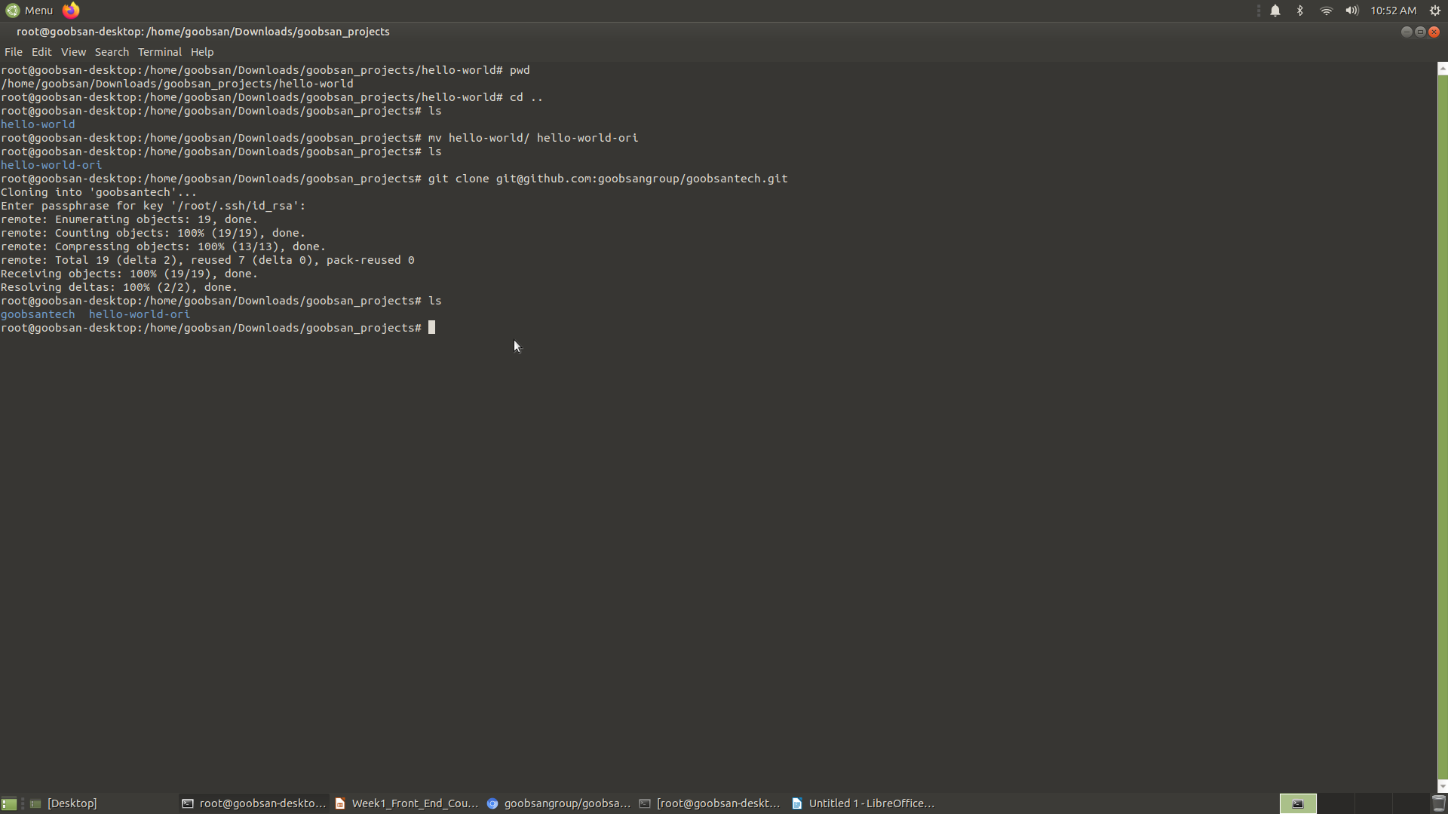

Slide 63
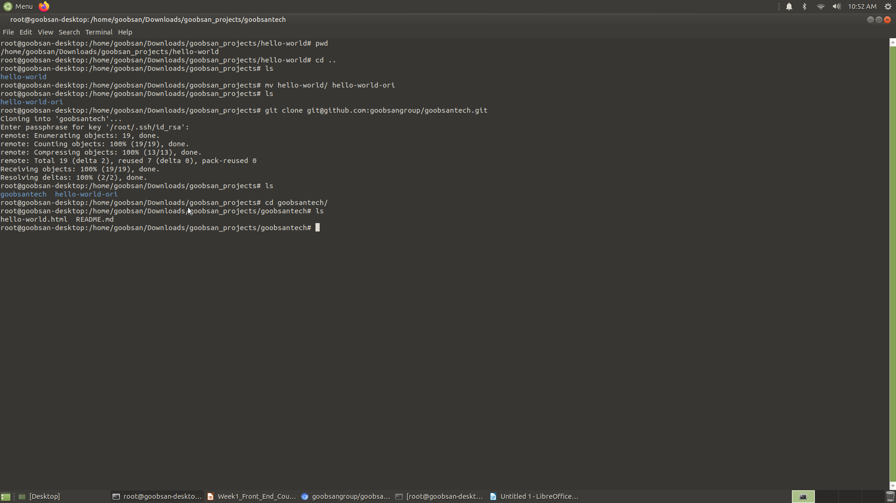

Slide 64
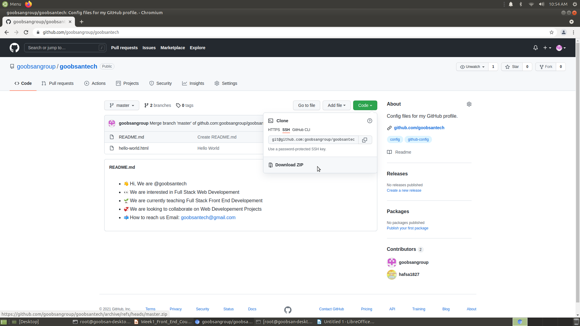

Slide 65
Practice GIT Commands
Tracking Changes
Create a new project directory with Git repository In the terminal type these commands:
$ mkdir project-name
$ cd project-name
$ git init
After adding files or making changes, track the changes.
Use this command to add all changes:
$ git add .
Use this command to add a specific file (replace filename.html with the name of the file to add):
$ git add filename.html
Commit the changes.
In terminal:
$ git commit -m "add a short, descriptive present-tense message here describing the changes made"
Create repository for project on GitHub at https://github.com/new

Slide 66
Continue..
Add the remote to the project.
In terminal:
$ git remote add [remote name] [remote URL] [remote name]: Name of the remote.
[remote URL]: The URL of the remote on GitHub.
For example, this command adds a remote named origin to the repository at https://github.com/goobsan/hello-world:
$ git remote add origin https://github.com/goobsan/hello-world.git
Push the changes to GitHub. In terminal:
$ git push [remote name] [branch name]
[branch name]: Name of the branch you're working on.
For example, this command pushes to the remote named origin to the master branch:
$ git push origin master

Slide 67
Continue..
Clone repository from GitHub. In terminal:
$ git clone [remote URL]
For example, this command clones the repository at https://github.com/ goobsan /hello-world:
$ git clone https://github.com/ goobsan /hello-world.git

Slide 68
Git Commands Overview
Project Setup
$ git init: Initializes new local Git repository in the current directory.
Tracking Files
$ git add .: Adds ALL files with changes to be committed.
$ git add [file]: Adds the named file to be committed.
$ git commit -m "[message]": records all of the staged files permanently to the version history; message should describe the changes finishing the phrase "This commit will…".
Example: $ git commit -m "add submit functionality for the form"
Remote Repositories
$ git remote add [remote name] [remote URL]: Adds a remote with the name specified for the repository to the remote URL provided.
$ git remote -v: Shows the names and URLs for all of the remote repositories that the project's Git repository has stored.
$ git push [remote name] [branch name]: Copies the code to the remote repository from the local Git repository.
$ git clone [remote URL]: Copies the code and commit history from a remote repository to a local repository.
Reviewing Git Info
$ git log: Lists commit history for the current branch.
$ git log --oneline: Lists a condensed format of the commit history for the current branch.
$ git status: Lists the files where changes have been made to be committed.

Slide 69
Forking with Git
Forking a Repository
A fork is a copy of a repository. Most commonly, forks are used to propose changes to someone's project or to use someone else's project as a starting point for your own idea. We are going to learn how to collaborate effectively later in the course. After working on your pair partner's computer and pushing changes to their GitHub account, there's the need to create a copy of the project in your own GitHub account.
To get started, open the GitHub repository
This is an external link. we will be working with throughout this lesson. On the top right corner of your screen, you should see a button with the text 'Fork' as shown in the image below. Clicking on this button should start the process of copying the project/repository to your own account. This is the open source. advantage of sharing projects on Github allowing people to collaborate on their work.

Slide 70
Continue..
Click on that button which should result in a modal prompting you to choose the account to which you want to fork. Select your account name which should take you to the repo you forked in your account. For example, if your GitHub username is 'iantheninja' just like mine is, you should select it and not anything else that appears in the modal. This may take a couple of seconds so be patient as the process takes place. To know that the forking process is complete, check the top left corner of your repo. You should be in your account in a repo with the same name as the original repository (your_username/delani_studio_site). This shows that the forking process is complete.
It shows that you are now working on your forked version that was forked from iantheninja/delani_studio_site. Having copied iantheninja's repo to your own account, we can then proceed to clone it like we learned to do in the previous lesson. Remember that cloning makes a copy in a location on your device, in this case, your laptop.

Slide 71
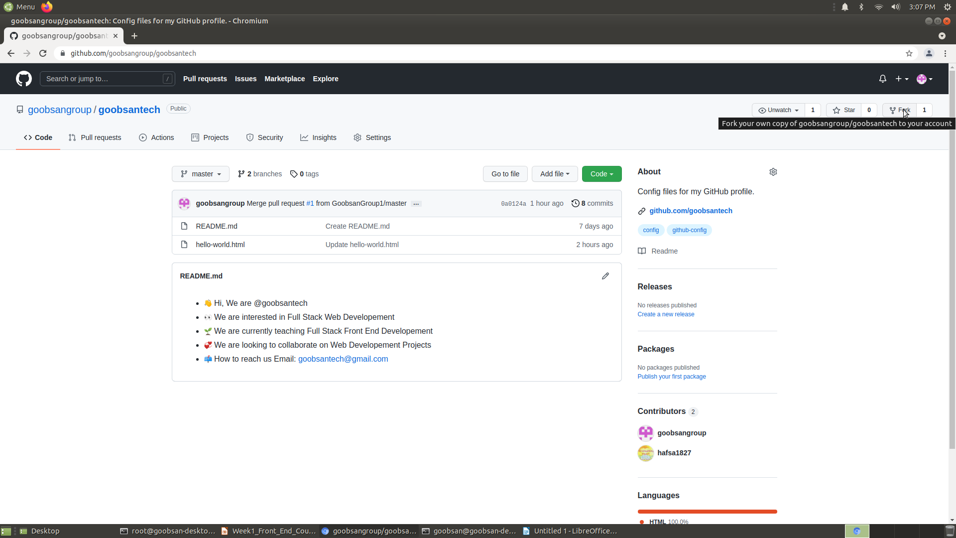

Slide 72
HyperText Markup Language (HTML)
The web is made up of mostly text files - like the ones you created to write your papers in high school - as well as some other files like images or videos. These files are stored on computers that are connected over networks. When you put a web site's address into your browser, you are really just requesting to see a particular file, or combination of files.

Slide 73
HTML
The goal of this section is to illustrate how simple HTML is to read and write by showing some text written in HTML and what it looks alike when it displayed in web browser
HyperText, or the "HT" of HTML, is just a fancy word for text that links to something else. The "ML" of HTML stands for markup language. As we can see in the example above, the text in the HTML file is normal text that is marked up with instructions written inside of these angle brackets <>, known as tags. The actual language of HTML is the instructions that we wrap around the text to format it and as we'll see, instructions for many other things like images, links, videos and more.

Slide 74
Indentation and Spacing
Before we start writing any HTML, it's important that we go over some rules to make sure that we're writing our code properly.
When writing HTML (or any other programming language), well-written code follows consistent indentation and spacing patterns. In some languages, indentation and spacing are required for the code to function properly. In HTML, inconsistent indentation and spacing will not impact the functionality of the web page but will cause your code to be difficult to read and understand.

Slide 75
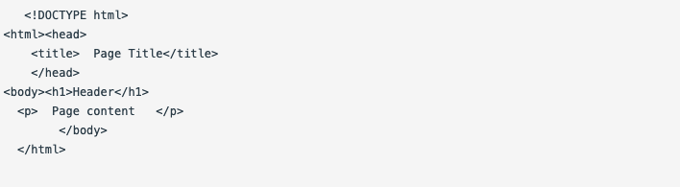
Continue..
Consider this example of HTML with poor indentation and spacing:

Slide 76
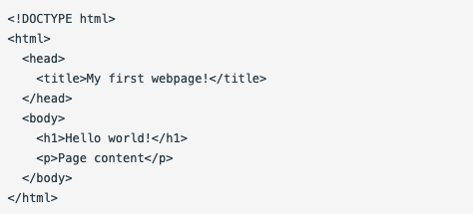
Continue..
At first glance, it's difficult to see where elements begin and end, and what elements are nested within each other. Nested is another way of saying that the start tag and end tags of one element are inside of the start and end tags of another element.
Here's the same code with proper indentation and spacing:

Slide 77
Continue..
In HTML, start tags and end tags on different lines are always left-aligned with one another. For example, when I see the <html> tag, I can scan vertically down to see its closing tag. It's clear that <head> and <body> are nested within <html>. The same goes for the <head> and <body> tag alignment.
When an element is nested inside another element, it needs to be indented two spaces from the opening tag. You can see in the above example that <head> is indented two spaces from <html>, and <title> is indented two spaces from <head>.
With a text editor like Atom, you can use the tab key to indent quickly. If you use the tab option, make sure tabs are set to two spaces. Some defaults are set to other amounts, such as four spaces, which is too much white space for HTML and is not standard practice.
To check your settings in Atom, go to the menu bar and select Atom > Preferences, then choose the Editor menu in the sidebar and scroll down to Tab Length.

Slide 78
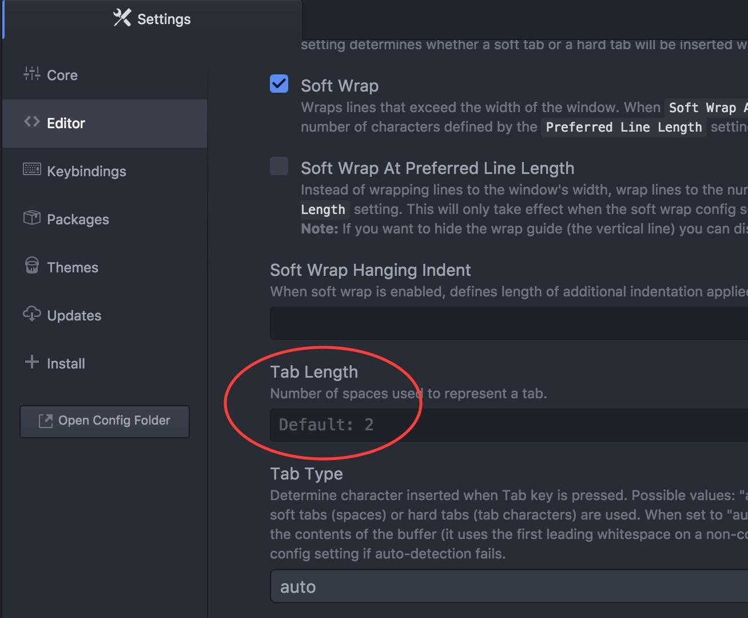

Slide 79
Continue..
Also, notice that there is no space between the text content of an element and its tags. For example, <h1>Header</h1> has no spaces between <h1> and the word Header.
Regardless of the language that you use to write code, learn its conventions for indentation and spacing. Getting in good habits now is much easier than breaking bad habits later. Practice consistency so that your code is easily understood by other developers, as well as yourself.

Slide 80
Creating a Web Page
Let's create a project directory and initialize a Git repository for a new project called my-first-webpage.
As a review, here are the steps:
Open Terminal.
Make a project directory called my-first-website in your Desktop directory:
$ mkdir my-first-website.
Navigate into the project directory you just created: $ cd my-first-website.
If you type $ pwd
Within your project directory, initialize your Git repository: $ git init
Create an empty file: $ touch my-first-webpage.html.
We gave our HTML document the file extension ".html", which tells our computer that it is an HTML file, and that it shouldopen the file in a web browser.
Open the project directory in Atom: $ atom .
The command atom . opens the entire directory you are currently in because the . refers to current directory. If you only want to open the single file, you could instead type: $ atom my-first-webpage.html.

Slide 81
Continue..
my-first-webpage.html
<!DOCTYPE html>
<html>
<head>
<title>My first webpage!</title>
</head>
<body>
Hello, world! Welcome to my first webpage!
</body>
</html>

Slide 82
We've created our first web page - let's commit it!
$ git add my-first-webpage.html
$ git commit -m "add initial page structure”

Slide 83
Block Elements
We're going to start adding content to our page by working with block elements. These are HTML elements that start on their own line when displayed, like a "block" on the page. In this lesson, we will learn how to add paragraphs, headers, and lists to our pages.
Open up my-first-webpage.html and modify it so that it looks like this:
my-first-webpage.html
<!DOCTYPE html>
<html>
<head> <title>My first webpage!</title>
</head>
<body>
<p>Hello, world!</p>
<p>Welcome to my first web page!</p>
</body>
</html>

Slide 84
Continue..
The formatting instructions around the text are called tags. The <p> is called a p tag. It means that everything that follows is a paragraph, until </p> is reached. The </p> is called a closing tag or end tag and indicates the end of the paragraph. Closing tags always match the header but have a backslash in front.

Slide 85
Continue..
We've just made a change to our code. Time to commit!
$ git add my-first-webpage.html
$ git commit -m "add paragraph block elements to the page" Let's try some more tags:
my-first-webpage.html
<!DOCTYPE html>
<html>
<head> <title>My first webpage!</title> </head>
<body>
<h1>My First Webpage</h1>
<h2>Written with a little guidance from Moringa School</h2>
<p>Hello, world!</p>
<p>Welcome to my first web page!</p>
</body>
</html> Here, we've added a main header (<h1>My First Webpage</h1>) and a subheader (<h2>Written with a little guidance from Moringa School</h2>).

Slide 86
Continue..
There are six different levels of headers you can add using <h1> through <h6>. Like the paragraph tags, we have an opening tag that indicates where the header begins (<h1>) and a closing tag that indicates where it ends (</h1>).
HTML ignores empty spaces and blank lines, which is called whitespace. That's why the extra line we might add between our headers and paragraphs doesn't do anything when the HTML is displayed. We could take it out, or make it three spaces, and it would look exactly the same in the browser.
Let's commit again!
$ git add my-first-webpage.html
$ git commit -m "add header block elements"

Slide 87
Continue..
Let's add a little bit more:
my-first-webpage.html
<!DOCTYPE html>
<html>
<head> <title>My first webpage!</title>
</head> <body> <h1>My First Webpage</h1>
<h2>Written with a little guidance from Moringa School</h2>
<p>Hello, world!</p>
<p>Welcome to my first web page!</p>
<p>Here are some things I'm going to learn about coding:</p>
<ul>
<li>HTML</li>
<li>CSS</li>
<li>JavaScript</li>
<li>And a lot more!</li>
</ul>
</body>
</html>
Here we've added an unordered list (<ul>) with four list items (<li>). Here's the page with the unordered list:

Slide 88
Continue..
If we wanted to make an ordered list that uses numbers and letters instead of bullets, we would use an <ol> tag instead of <ul>:
<ol>
<li>HTML</li>
<li>CSS</li>
<li>JavaScript</li>
<li>And beyond!</li>
</ol>

Slide 89
Practice: Block Elements
Warm up
Discuss the following questions with your partner:
Why is indentation and spacing important?
What is an opening tag? What is a closing tag?
What does it mean when an element is nested within another? Can you give an example of when we would use nested elements?
Code
First, follow along with the lesson and add the block elements to the page. Then, open up the my-favorite-things.html and add some block elements. Some to consider:
Add an <h1> containing the page title
Add an unordered list (<ul>) of your best friends
Add an ordered list (<ol>) ranking your favorite foods
Add a paragraph (<p>) about some of your favorite things

Slide 90
Inline Elements
All of the tags we learned about in the previous lessons are block elements, meaning that each element is displayed on a new line. In this section, we are going to look at elements that do not appear on their own line but share a line with other elements. These are called inline elements. We will see how to add text emphasis, links, and images to our pages.

Slide 91
Continue..
Open up my-first-webpage.html. We're going to modify it to include an inline element:
<p>Welcome to my <strong>first web page</strong>!</p>
The <strong> tag indicates that something is important. By default, it will make the text inside it bold.
If we want to emphasize something, we'll use the <em> tag, which will italicize it:
<h2>Written with a little guidance from <em>Goobsan School</em></h2>

Slide 92
Continue..
Links
And now let's learn about one of the most useful HTML tags. Add the following line to the end of the <body> element:
<p>Check out <a href="http://goobsanschool.com/">Goobsan School</a>. It's a great place to learn web development skills!</p>
The anchor tag, <a>, creates a link to the address at the href attribute, or hypertext reference. An attribute is something that further defines what a tag does - in this case, it tells the link where to go.
We can also use the <a> tag to link from one document to another. For example, if you've been following along with the exercises and have favorite-things.html in your project directory, you can link to it from index.html like this:
<p>Here is a link to my <a href="favorite-things.html">favorite things</a>.</p>

Slide 93
Continue..
Images
Let's learn about one more inline tag, which will allow us to add images to the page. Find an image of an elephant online, save it in the my-first-webpage folder with the name elephant.jpg, and then display it on our page like this:
<img src="elephant.jpg" alt="A photo of an elephant">
Notice that the <img> tag is a little different than the other tags that we've seen: it's self-closing, meaning that it does not need a closing tag - in other words, it doesn't need one of these: </img>. The srcattribute tells the tag where to find the image, and is required.
The alt attribute is typically a description of the image, and is optional. However, it's a good idea to include for a few reasons. First, if the image fails to load, the user can hover the mouse over the image's area and read the alt text for a description of the image. Second, visually impaired users often browse the web with the aid of screen reading software. When you include the alt attribute, the screen reading software can read the image's description out loud to the user.
Typically, websites will store their images in a separate folder from the rest of the HTML. Create a folder named images in the main project directory and move the image there.

Slide 94
Practice: Inline Elements
Warm Up
Discuss the following questions with your partner:
What is the difference between a block element and an inline element?
What does it mean to provide a relative path?
What is an HTML attribute? Can you give some examples of ones that we have seen so far?
Code
Add some inline elements to my-favorite-things.html. Some to consider:
Add some images to represent your favorite things
List your favorite websites and provide links to them
Add some <strong> and <em> tags at appropriate places
Next, update your website to include images, links, strong, and em tags.

Slide 95
Discussion: Indentation and Spacing
Discuss the following:
Why is indentation and spacing important? What benefit is there to ensuring that it is consistent?
When do we indent?
How many spaces should make up one indent?
If we wanted to change the little icon that displays next to the page title, would that code go in the <head> or the <body>?
What is an opening tag? What is a closing tag? What does it mean when an element is nested within another? Can you give an example of when we would use nested elements? What is the difference between a block element and an inline element? What does it mean to provide a relative path? What is an HTML attribute? Can you give some examples of ones that we have seen so far?

Slide 96
README
Every GitHub repository should have a README.md file. It's often the first thing someone new to your project sees and is frequently the only source of documentation. The READMEs we will write will have the extension,.md which stands for Markdown. Like HTML, Markdown is a language that uses annotations to format the display of text.
The README file should be located in the top level of the project directory. GitHub knows to look for a file named "README" and display the contents on the repo's viewing page.
It's worth taking the time to make your README look presentable because it will be the first thing anyone will see in your repositories. You want to make a solid first impression - if people see that you have a messy or incomplete README, they will assume that your code is also messy or incomplete. You want to make it as easy as possible for your users (such as potential employers) to check out your code. Writing a strong README is a good way to practice - and showcase - your empathy as a developer.

Slide 97
Continue..
As you can see from these examples, READMEs vary widely from one repository to the next, depending on the project needs. This is why it's important that your README is well-organized and easy to read. Mostly recommends including as a minimum the following sections:
Application name
Names of contributors
Description of the project's purpose
Complete setup/installation instructions
License information with a copyright and date
Additional sections to consider:
Live demo
Instructions on running tests
Technologies used
Future features or to do list
Known bugs
Contact information
Support or contribution instructions

Slide 98
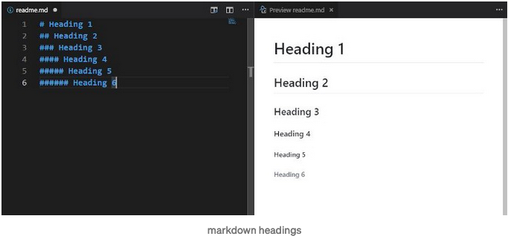
Markdown Language
Headings
For writing headings, you have to add hash # symbol at the beginning of the line. The number of the hash symbol will increase heading type will change according to that.

Slide 99
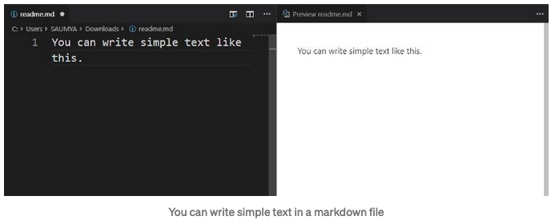
Continue..
Normal text
If you want to write normal text then write simple text here, no need to add any tags it will automatically convert into text.

Slide 100
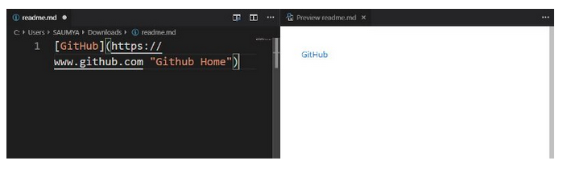
Continue..
Hyperlinks
You can add a hyperlink in a markdown file by using the below tag.
[link name](targetURL)
e.g. [Github](https://www.github.com)
You can also write link title (While hovering over the link the title will appear)
[link name](targetURL "Link title")
e.g. [Github](https://www.github.com "Github home")
note: Make sure a single space should be their between targetURL and title)

Slide 101
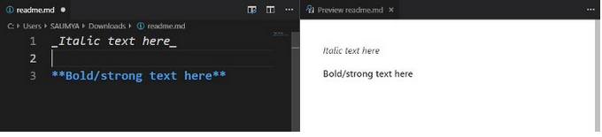
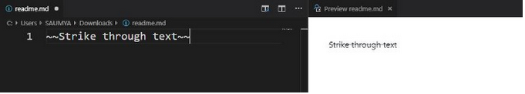
Continue..
Strong and italic text
You can write strong and italic text by appending underscores _ before and ending of the line, for italic text add double star ** before and ending of the line for strong/bold text.
_Italic text here_
StrikeThrough
If you want to strike through a word or line then add two tilde symbol at the beginning and end of the line.
~~Strikethrough text~~

Slide 102
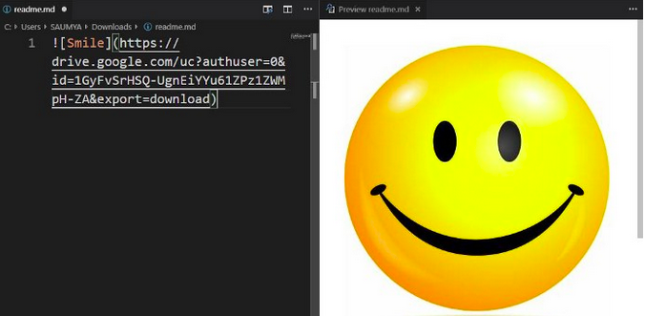
Continue..
Images
You can add images in a markdown file by using the below tag.
![imagename](TargetUrl)

Slide 103
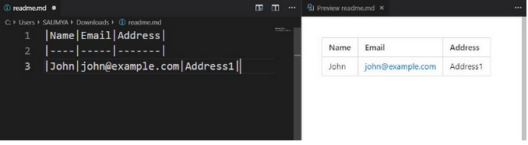
Continue..
Tables
You can write a table by using the below format of text.
|Name|Email|Address| <====== This is the heading of the table
|----|-----|-------| <====== This is the separator.
|John|john@example.com|Address1| <=== This is the table body.

Slide 104
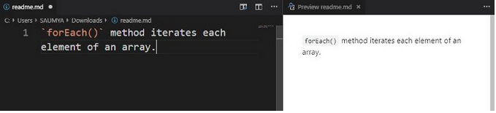
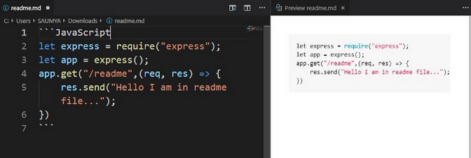
Continue..
Code
You can write code by appending ` symbol at the beginning and end of the line.
Code block
If you want to write a block of code then add ``` at starting and ending of the code.
You can specify your language after the ``` at starting of the line.

Slide 105
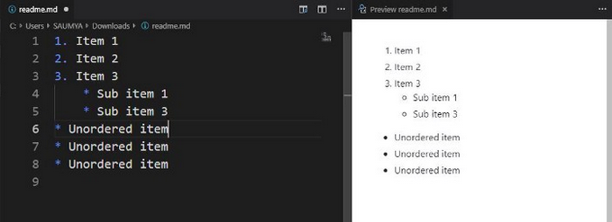
Continue..
List
You can write an ordered list, unordered list, and mixed list. Please see the below format how to write a list.
1. Item 1
2. Item 2
3. Item 3
* Sub item 1
*Sub item 3
* Unordered item
* Unordered item
* Unordered item

Slide 106
# {Application Name}
#### {Brief description of application}, {Date of current version}
#### By **{List of contributors}**
## Description
{This is a detailed description of your application, including its purpose and usage. Give as much detail as needed to explain what the application does, and any other information you want users or other developers to have. }
## Setup/Installation Requirements
This is a great place
* to list setup instructions
* in a simple
* easy-to-understand
* format
{Leave nothing to chance! You want it to be easy for potential users, employers and collaborators to run your app. Do I need to run a server? Do I need to install any dependencies? How should I set up my databases? Is there other code this app depends on?}
## Known Bugs
{Are there issues that have not yet been resolved that you want to let users know you know? Outline any issues that would impact use of your application. Share any workarounds that are in place. }
## Technologies Used
{Tell me about the languages and tools you used to create this app. Assume that I know you probably used HTML and CSS. If you did something really cool using only HTML, point that out.}
## Support and contact details
{Let people know what to do if they run into any issues or have questions, ideas or concerns. Encourage them to contact you or make a contribution to the code.}
### License
*{Determine the license under which this application can be used. See below for more details on licensing.}*
Copyright (c) {year} **{List of contributors or company name}**

Slide 107
README practice
Warm Up
Discuss the following with your partner:
What are some features that make up a good README?
How is Markdown similar to HTML? How is it different?
What is an open source license? Why is it a good idea to include one?
Code
Add a README to one of each of you and your partner's projects.

Slide 108
Continue..
Licensing
An open source license details how others can use your code. Adding a license to your repository is a good practice because it is how you state your intent.
MIT and GPL are the most common licenses. An MIT license means your code is free to use by anyone and you are not liable (Rails and jQuery use an MIT license). GPL also indicates free usage of the code but when used, the resulting work MUST be open source (Linux, Git and Wordpress use GPL).

Slide 109
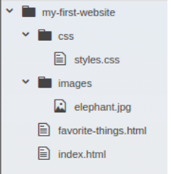
Introduction to CSS
So far, the sites we've made have not been very exciting. In this lesson, we're going learn how to change that with CSS, which stands for Cascading Style Sheets. CSS is a language that lets us add style to our webpages. It lets us separate the page content and structure from the style and appearance.The cascading in the name refers to the way that styles are applied to an element - we'll get more into that later.
Let's go back to our my-first-website project. Open up the project in Atom and add a folder named css to the main project directory. Create a file named styles.css inside of the folder. Your directory structure should look like this:

Slide 110
Continue..
First, we need to tell the HTML document to use this CSS. The reference typically goes in the <head> section like this:
<head>
<title>My first webpage!</title>
<link href="css/styles.css" rel="stylesheet" type="text/css"> </head>

Slide 111
Continue..
The <link> element links the HTML and CSS files together. It must be placed within the head of the HTML file. It is a self-closing tag and requires the following three attributes:
href - like the anchor element, the value of this attribute must be the address, or path, to the CSS file.
type - this attribute describes the type of document that you are linking to (in this * case, a CSS file). The value of this attribute should be set to text/css.
rel - this attribute describes the relationship between the HTML file and the CSS file. Because you are linking to a stylesheet, the value should be set to stylesheet.
Now let's add some CSS to styles.css to see what this looks like:
css/styles.css

Slide 112
Continue..
h1 { color: blue; }
Save the file and refresh the page, and see that the header is now blue.
What we just wrote is known as a CSS rule. It is made of two parts: the selector and the declaration. In the above example, h1 is the selector, or the HTML tag to which the rule is applied. Everything inside of the curly braces is the declaration, which defines of the styles to be applied to the selector. The declaration is made of two parts: the property (color in this case) and the value (blue), and they are separated by a colon.
A declaration can contain more than one property. Each property is separated by a semicolon:
h1 {
color: blue;
text-align: center;
}

Slide 113
Continue..
h1
{
color: blue;
text-align: center;
}
h2 {
color: green;
font-style: italic;
text-align: center;
}
p {
font-family:
sans-serif;
}
ul {
line-height: 40px;
}

Slide 114
Continue..
Go ahead and refresh the page and see the changes. All these rules are pretty straightforward.
For h2 tags, we've set the color to green, the font style to italic, and the text alignment to the center of the page.
For p tags, we've set the font family to _sans serif), which is a type of font.
For ul tags, we've set the line height to 40 pixels - px is short for "pixels".
It's worth noting here that named colors, such as blue for h1 and green for h2, are not commonly used. More likely, you will see three- or six-digit hexadecimal codes to define color, like this:
h1 {
color: #00f;
} or this:
h1 {
color: #0000ff;
}

Slide 115
Continue..
Both of these are equivalent to blue. There are numerous tools online for picking colors and hex codes, such as htmlcolorcodes.com This is an external link..
You may be wondering why we made h2 italic using the font-style property instead of using <em>tags like we did in a previous lesson. There are a few reasons for this. First, we can modify the <em> tag just like any other HTML tag. <em> stands for emphasize, and eventually, we may decide that we want to emphasize text by bolding it instead of italicizing it, which we may not want for our h2s. Second, one of the advantages of CSS is that we can change style in many places at the same time. What happens when we add another h2? We have to add <em>s again so that it has the same formatting. Say we want our h2s to be bold as well. Now we have to add <strong> tags We end up repeating ourselves with many opportunities to miss something. By using CSS, we only need to change the style in one place, and every <h2> on every page that uses that CSS file will be updated.
Let's take a second to reflect on this last point. It's in the nature of websites that even after they're built, they are bound to change: there will be additions, deletions, overhauls, and more. CSS gives us some powerful tools to change what we've built. Remember: good code is code that is easy to change.

Slide 116
Debugging HTML and CSS
Learning to debug your code is an essential skill as a developer. There are many debugging techniques out there, and I'm going to introduce you to a few techniques you will use all the time for HTML and CSS.
These instructions are for Google Chrome. Both the JavaScript Console and Inspect panel discussed below are part of Chrome Developer Tools, or DevTools.

Slide 117

Continue..
JavaScript Console
To access DevTools, select More Tools > Developer Tools from Chrome's main menu (the three dots in the top right corner of the window). As a shortcut, you can also press Ctrl + Shift + J (Linux or Windows) or Cmd + Option + J(Mac). You may also have to click the Console tab at the top of the window that pops open.
This window is called the JavaScript Console. Although we're not working with JavaScript, this is also where errors in the web page are logged. If you see something that looks like Failed to load resource file:///Users/moringa/css/styles.css, Chrome is telling you that it was instructed to look for your CSS file at Users/moringa/css/styles.css, but the file wasn't there. In other words, you either gave the wrong path to the file, or you put the file in the wrong place.

Slide 118

Inspect Element
Another very useful tool in debugging web pages is Inspect Element. To access this tool, open any webpage and right-click a page element and select Inspect. As a shortcut, you can also press Ctrl + Shift + I(Linux or Windows) or Cmd + Opt + I (Mac). You may click the Elements tab at the top of the DevTools window. A window will pop open revealing the source code for the page, with the selected element highlighted in blue.
With an element selected, you can see CSS in the Styles tab. This makes it easy to see what rules have been applied, including those that have been overridden due to specificity or order of other rules (these will be crossed out). Here is what the Styles tab looks like with overridden rules:

Slide 119

Continue..
You can also uncheck a rule to disable it, or double-click a rule to edit it and see the change live. You can even add new rules and see what they would do live.
You won't have much space to work with Inspect Element at the bottom of your screen, so click the three vertical dots on the top right-hand side of the inspect element pane near the "X" (which you'd click to close the pane). Now, you'll see an option to move the pane to the right-hand side of your browser (dock to right), move the pane to the bottom of the browser window (dock to bottom) or to open the pane in a completely separate window (undock into separate window).

Slide 120
Independent Project
Requirements
Here are the requirements for your page:
Your name
An image of you or something that represents who you are
A list of projects you have created with active links to them (either on GitHub or GitHub pages)
For each, include a brief description of the project and what languages it uses
An "About Me" section including:
Your background (for example, your education, job experience, a paragraph on why you decided to take a class on programming, etc.)
Your current interests/hobbies/skills
Deploy your site onto GitHub pages so that a live site can be viewed at your-username.github.io/portfolio (for example)

Slide 121
Objectives
In addition to these requirements, your portfolio will be evaluated on the following objectives:
Some of the most common HTML tags are incorporated, including:
p, h, ul, ol, li, em, strong, a, img, div, span
Page incorporates a custom-made stylesheet that uses cascading, the box model, and floats
Indentation and spacing of HTML and CSS is accurate.
Commits are made regularly with clear messages associated with them
Project is deployed to GitHub Pages
A project README that includes:
project or program name
author name
description of project
project setup instructions
link to live site on GitHub Pages
copyright and license information

